Slide 1
Scaling microbial strain inference to thousands of metagenomes using fuzzy genotypes
Multiscale Microbial Communities
2022-02-21
Byron J. Smith
Notes:
Thank you to TODO for the generous introduction, and thank you to the organizers for inviting me to present today.
I’m excited to tell you today about some very recent work on scaling up strain inference in shotgun metagenomic data.

Slide 2



More information
Scalable microbial strain inference in metagenomic data using StrainFacts. bioRxiv (2022) doi: 10.1101/2022.02.01.478746
https://github.com/bsmith89/StrainFacts
@ByronJSmith
Notes:
You can find the method and all of the results that I present today in a preprint that we uploaded last month to BioRxiv
I’ll also direct you to StrainFacts on my GitHub
And you can tweet @ my handle shown here

Slide 3
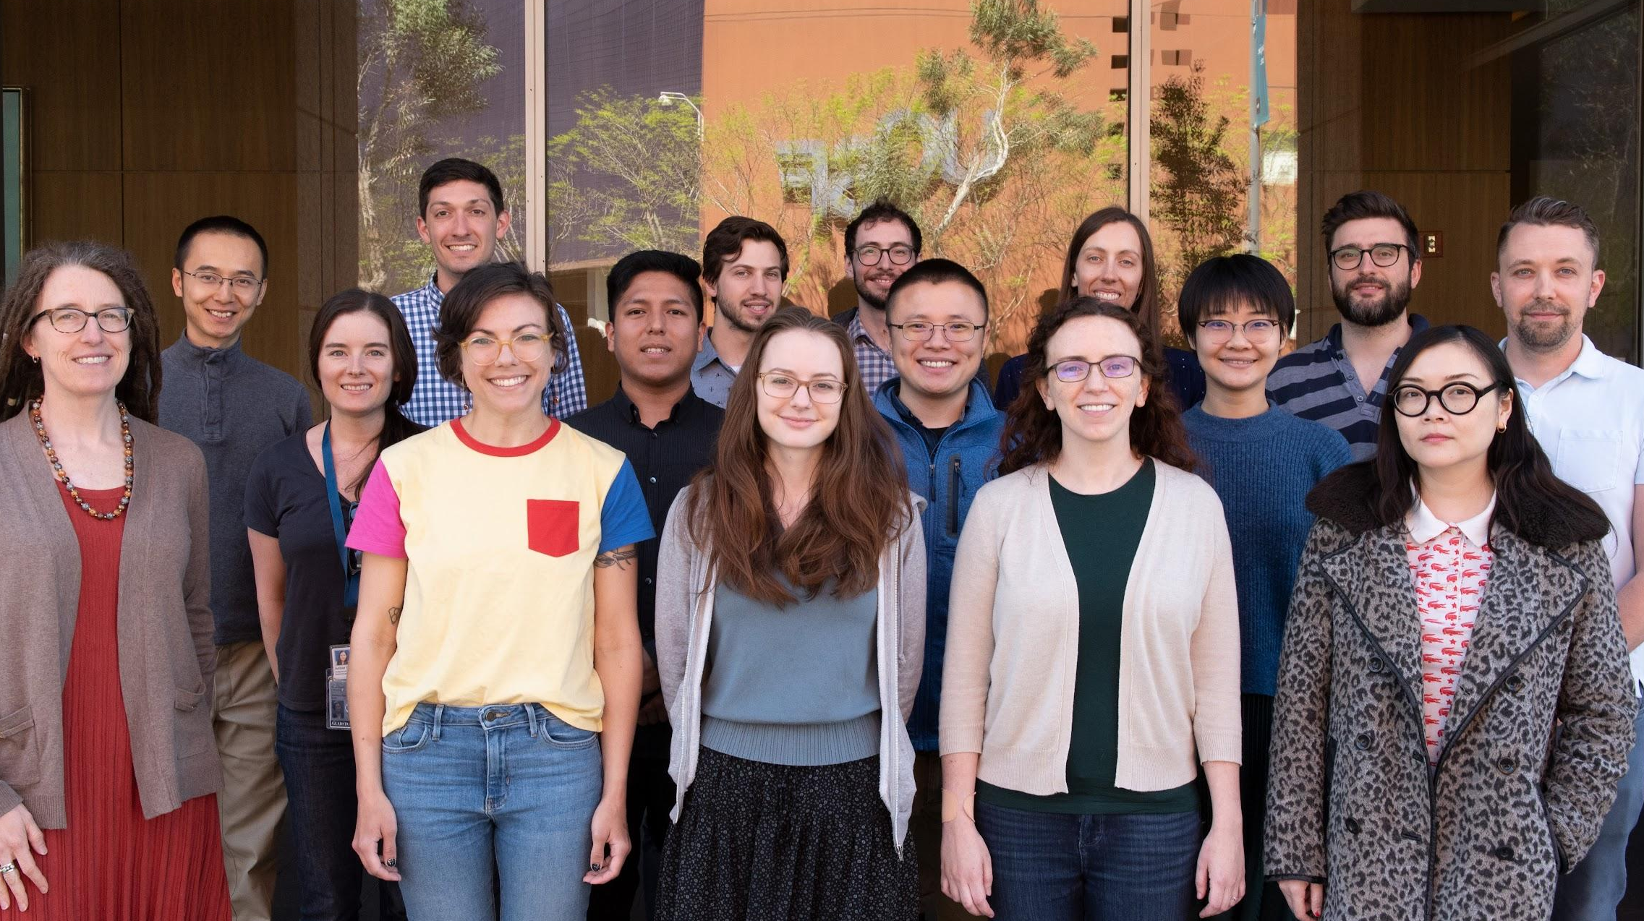
Acknowledgments
My Co-authors:
Xiangpeng Li
Jason Shi
Adam Abate
Katie Pollard
Pollard Lab
Gladstone Institute for Data Science and Biotechnology
Chan Zuckerberg Biohub
NIH T32 DK007007
UCSF Initiative for Digital Transformation in Computational Biology & Health
Notes:
Before I get started I should acknowledge colleagues, institutions, and funding sources without whom this project would not have been possible. In particular, i want to thank my co-authors, and in particular Katie Pollard for having been a wonderful mentor throughout my postdoc.

Slide 4
Outline
Intraspecific diversity in the microbiome
Strain inference
Metagenotype deconvolution
Application to large metagenome collections
Notes:
My talk today is roughly broken up into four sections
First, Introducing intraspecific diversity in the gut microbiome and why you should care
Then I’ll describe some of the existing methods for understanding strains using shotgun metagenomics (and their shortcomings)
Then I’ll lay out metagenotype deconvolution and how StrainFacts scales strain inference to large numbers of samples
Finally I’ll spend the last section of my talk showing a few exciting results from a large collection of publicly available metagenomes

Slide 5
Outline
Intraspecific diversity in the microbiome
Strain inference
Metagenotype deconvolution
Application to large metagenome collections
Notes:
Let’s jump right in!

Slide 6
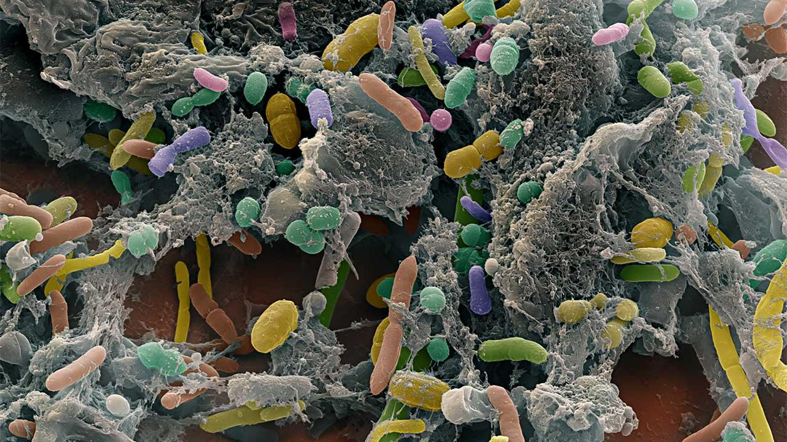
Human associated microbes are diverse and important
Notes:
So before I tell you why you should care about strains in the human microbiome, let me start by very quickly telling you why you should care about the microbiome.

Slide 7
Human associated microbes are diverse and important
Important:
Digestion
Pathogen resistance
Immune modulation
Diverse:
Hundreds of bacterial species
Also archaea, eukaryotes, and viruses
High inter-individual variation
Notes:
Microbes inhabiting the gut play important and well documented roles in host health.
Besides very obvious impacts like diseases, gut microbes also play a documented role in digestion of food, pathogen resistance, modulating the immune system, and more
I also want to stress how diverse the microbiome is, both within a single individual who can have hundreds of bacterial species (not to mention numerous archaea, protists, and viruses)
But also between individuals, which usually have more differences than similarities.

Slide 8
Human associated microbes are diverse and important
Important:
Digestion
Pathogen resistance
Immune modulation
Diverse:
Hundreds of bacterial species
Also archaea, eukaryotes, and viruses
High inter-individual variation
Huge (but under-explored) diversity within species
Notes:
The focus of this presentation, however, will be on a different kind of diversity: within-species diversity.
It is becoming increasingly clear that when considering microbes at a strain-resolution, the intra-individual and inter-individual diversity is even higher, potentially with important impacts on the functions of the microbiome

Slide 9
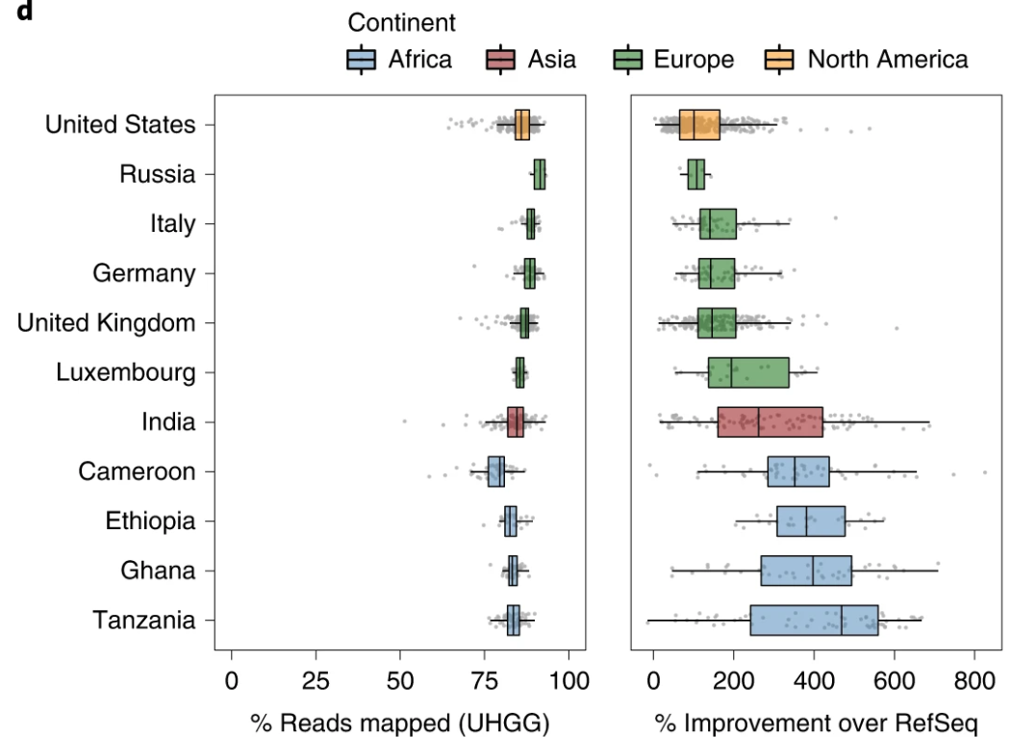
Reference databases are approaching a complete catalog of species in the human gut
Key efforts include the Unified Human Gastrointestinal Genome (UHGG)
Includes metagenome assembled genomes (MAGs)
204,938 genomes in 4,644 species
Remaining disparity from understudied human populations
Almeida, A. et al. Nat Biotechnol 39, 105–114 (2021).
Notes:
This understanding is being made possible by microbial genome references.
After 20+ years of studying the human gut microbiome, projects like the unified human gastrointestinal genome (UHGG)—which specifically harnesses culture-free genomes (MAGs)—are nearing a complete representation of species in the human gut.
I say this based on results like the figure on the right, which I’ve borrowed from the UHGG paper in 2021, which shows the fraction of shotgun metagenomic reads that map to that reference database, now finally >75-90%, which is a 2x or greater improvement over previous databases.
It’s still important to point out that the degree of database coverage is lower in understudied populations, as we can see with samples from these four African nations. There’s still more work needed to gather a truly representative database.

Slide 10
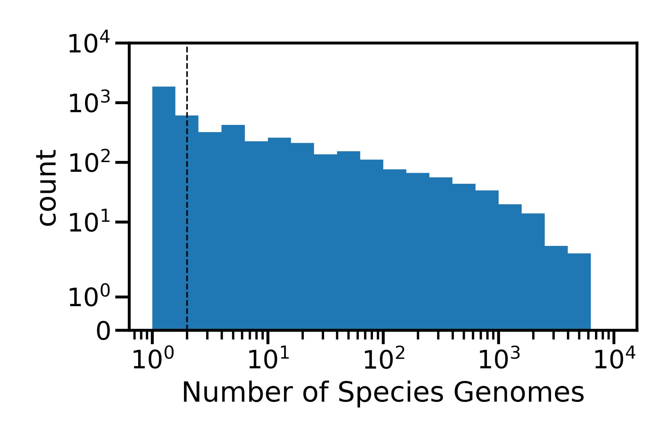
Strain diversity is not well documented for vast majority
75% of species have fewer than 10 representative genomes
Notes:
What’s more, while we might now have a reference for the most common species
For the large majority of species, we don’t have much strain diversity represented
The median number of representative genomes across all species in the UHGG is 2
And 75% of species have fewer than 10 genomes.
This means that for most species we know little or nothing about intraspecific diversity

Slide 11
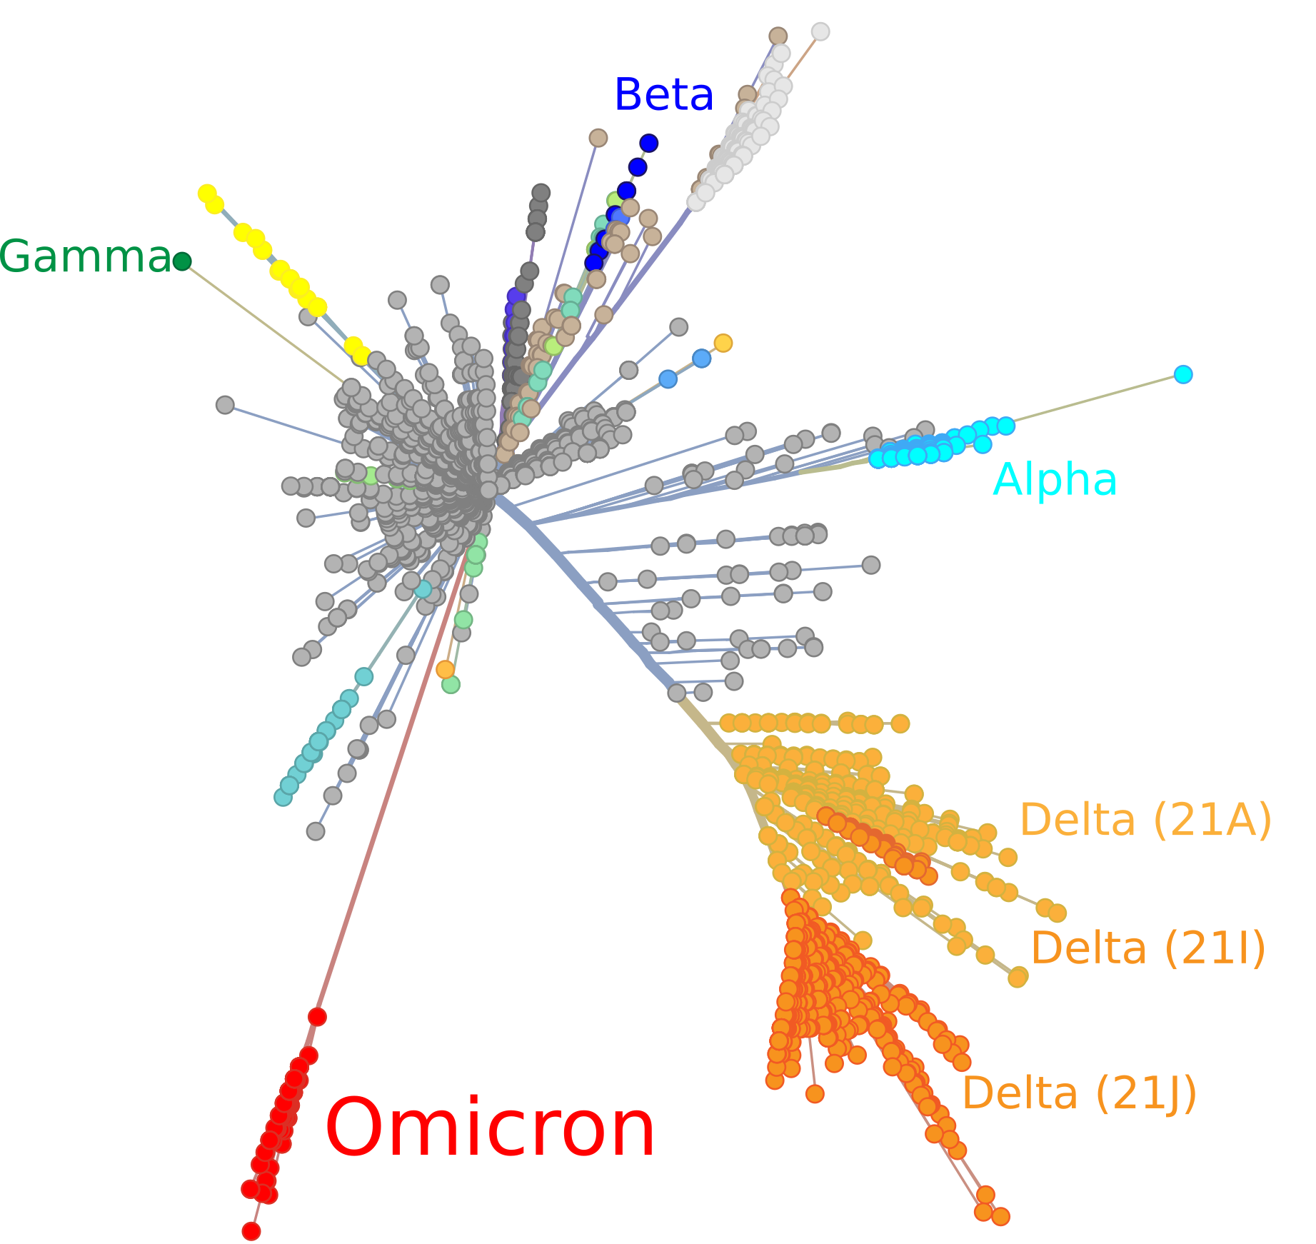
Strain diversity is both biologically important and scientifically informative
Differences between microbial strains can impact human health
Tracking strains between individuals, over time, or across global geography can help us to understand transmission patterns, disease associations, selection pressures, etc.
https://nextstrain.org
Notes:
And strain level diversity is important.
We’ve been talking about it for almost the last two years.
Just like SARS-coV-2, we can see important differences in the traits of different microbial strains
And like SARS-coV-2, sequence comparisons can also inform our understanding of microbial origins, transmission, ecology, and evolution

Slide 12
Strains of a species can have important differences
Intraspecific diversity has been appreciated for a long time
Pathogenicity
Antibiotic resistance
Phage resistance
Auxotrophy
Notes:
If that’s not enough motivation, we know a number of the ways that strain diversity can be biologically important in the gut microbiome
For instance, there are traits that are especially obvious, like pathogenicity and antibiotic resistance
Along with a few other traits like phage resistance and various metabolic auxotrophies.

Slide 13
Strains of a species can have important differences
Intraspecific diversity has been appreciated for a long time
Pathogenicity
Antibiotic resistance
Phage resistance
Auxotrophy
e.g. E. coli
Well studied, easy to culture
Notes:
One theme that I think is worth pointing out for these strain-specific traits is that they show up in E. coli and other model-microbes
These have been relatively easy to identify and study with a pure culture
But this is just the tip of the iceberg when it comes to strain-diversity

Slide 14
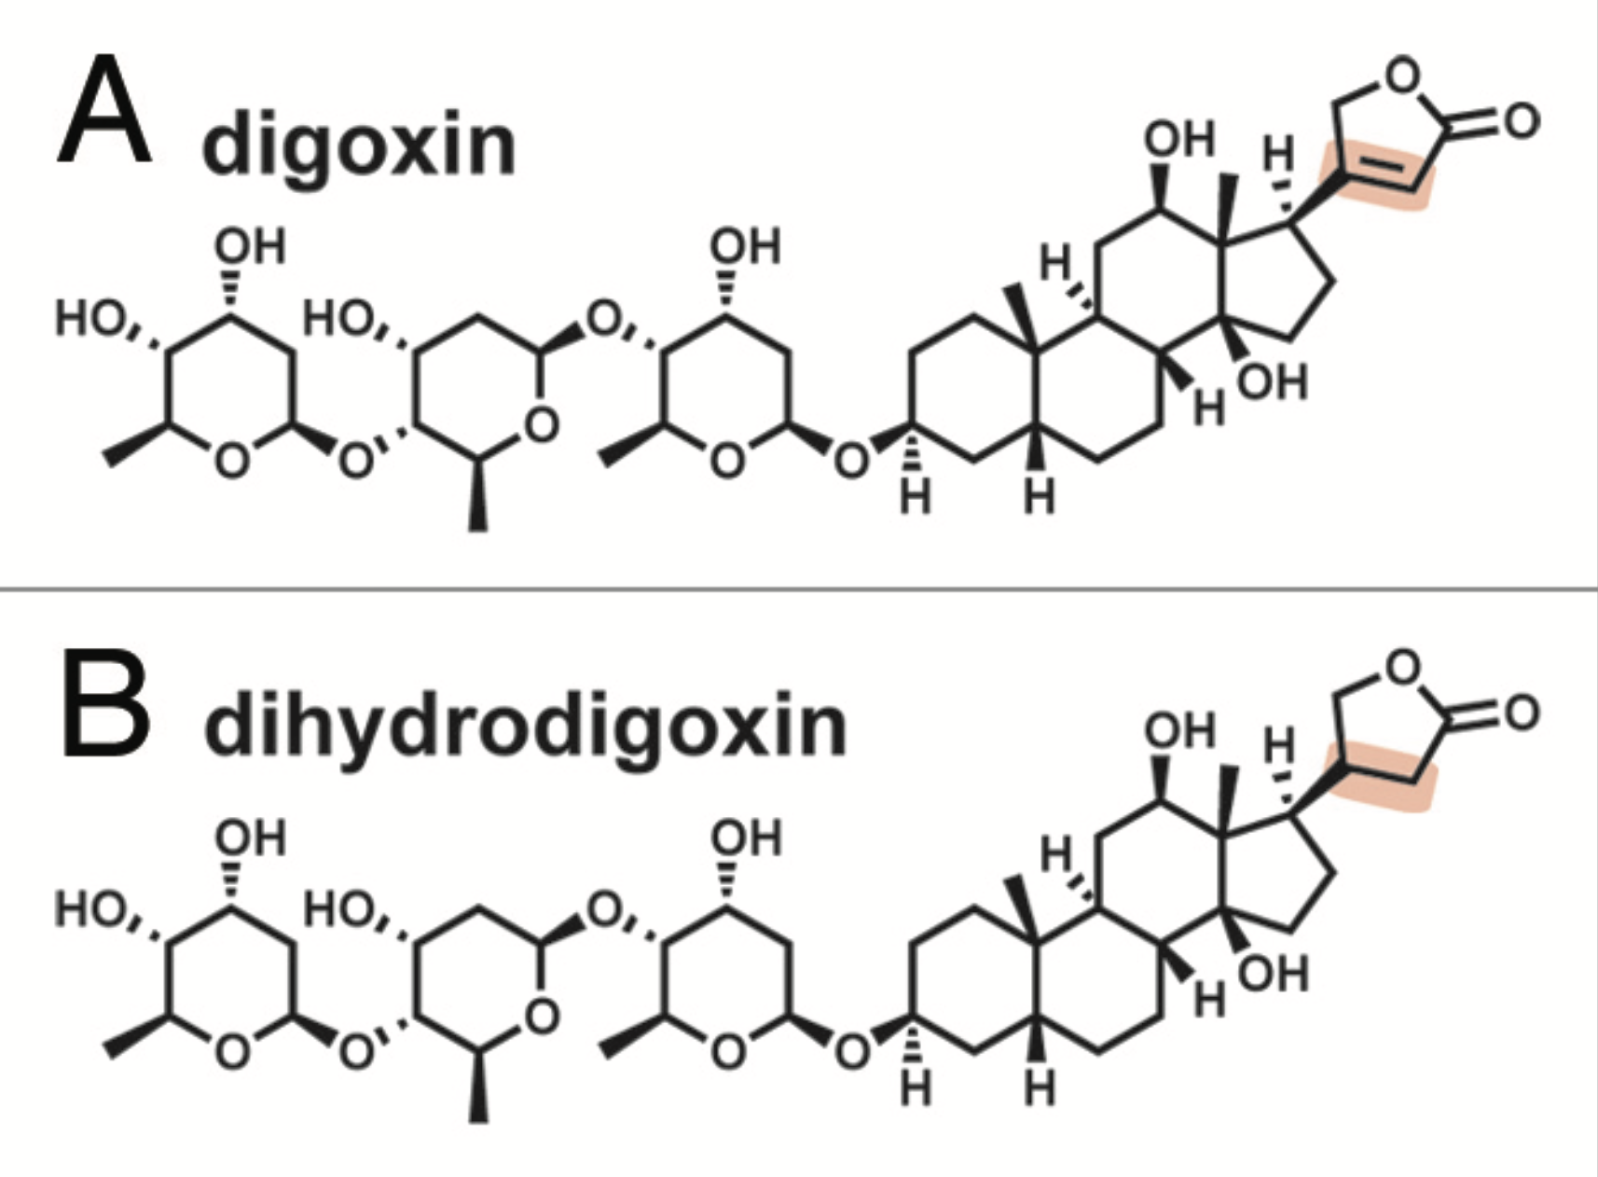
Strains of a species can have important differences
Intraspecific diversity has been appreciated for a long time
Pathogenicity
Antibiotic resistance
Phage resistance
Auxotrophy
e.g. E. coli
Well studied, easy to culture
active
inactive
Haiser, H.J., et al. Gut Microbes 5, 233–238 (2014).
Notes:
For instance, here’s a characteristic example: Digoxin is a cardiac glycoside, a commonly prescribed drug used to treat several heart conditions
However, when digoxin is reduced to dihydrodigoxin by some members of the gut microbiome it is inactivated,
changing its pharmacological profile in medically relevant ways

Slide 15
Strains of a species can have important differences
Intraspecific diversity has been appreciated for a long time
Pathogenicity
Antibiotic resistance
Phage resistance
Auxotrophy
e.g. E. coli
Well studied, easy to culture
active
Eggerthella lenta strains encoding the cgr-operon result in reduction/inactivation
of digoxin
inactive
Haiser, H.J., et al. Gut Microbes 5, 233–238 (2014).
Notes:
Importantly, while Eggerthella lenta is known to carry-out this process,
Only some strains have the cgr-operon that encodes this reduction
This motivates us to ask: “What other strain-specific traits are we missing when we only consider species-level taxonomy?”

Slide 16
What is a “strain”?
Diversity
Notes:
Before we go any further I want to quickly cover the semantics of the term “strain”.
If microbial diversity is conceptually flattened into two dimensions
we might see that every single isolate has something that distinguishes it from others

Slide 17
What is a “strain”?
Species B
Species A
Diversity
Notes:
We divide this diversity space at the largest level into species

Slide 18
What is a “strain”?
Species B
Species A
Strain 1
Strain 2
Strain 3
Diversity
Notes:
For this presentation, strains are groups of very similar genomes clustered within species
When we talk about “strain inference” I want to be clear that I’m using this operational definition of strains based on what we have the technical ability to differentiate.

Slide 19
What differentiates strains?
Gene content
Genotype
A
A
C
T
A
G
T
A
C
T
G
G
Notes:
And when I say similar genomes, I’m broadly referring to two different, but related things.
Strains can differ in
the set of genes encoded
Or the sequence of single-nucleotide variants at polymorphic sites within these genes

Slide 20
What differentiates strains?
Gene content
Genotype
A
A
C
T
A
G
T
A
C
T
G
G
Notes:
While the first is clearly very important, today I’m talking exclusively about the second
Differentiating strains based on the sequence of variants at SNP sites in the core genome

Slide 21
Outline
Intraspecific diversity in the microbiome
Strain inference
Metagenotype deconvolution
Application to large metagenome collections
Notes:
This is where strain inference comes in

Slide 22
Existing methods lack taxonomic resolution
Marker genes (e.g. 16S) are too conserved
Notes:
16S rRNA gene is highly conserved, and therefore has only limited phylogenetic resolution

Slide 23
Shotgun metagenomic data is increasingly available
Marker genes (e.g. 16S) are too conserved
Standard methods for taxonomic surveys assign reads to species based on read mapping
…
genome
Notes:
On the other hand, shotgun metagenomic data is increasingly available, raising many exciting possibilities in microbiome science.
However, standard methods for taxonomic characterization using metagenomic data are mostly limited to mapping reads to reference genome databases
and mostly only resolve taxonomy at the species level

Slide 24
Metagenomic reads encode strain-level information
Marker genes (e.g. 16S) are too conserved
Standard methods for taxonomic surveys assign reads to species based on read mapping
But shotgun reads also cover single-nucleotide variants that encode much finer taxonomic detail
…
genome
Notes:
Nonetheless, shotgun metagenomic reads mapping across SNP sites
include single-nucleotide variants that characterize strains

Slide 25
“Metagenotyping”
Marker genes (e.g. 16S) are too conserved
Standard methods for taxonomic surveys assign reads to species based on read mapping
But shotgun reads also cover single-nucleotide variants that encode much finer taxonomic detail
Metagenotypers tally variants at polymorphic positions (SNPs)
…
genome
alt
1
0
0
2
1
…
ref
0
1
2
0
0
Notes:
We call the process of tallying up all the alleles seen in reads covering each of these SNP sites: “metagenotyping”.
The “Genotyping” just like what we do for individual single organisms

Slide 26
“Metagenotyping”
Marker genes (e.g. 16S) are too conserved
Standard methods for taxonomic surveys assign reads to species based on read mapping
But shotgun reads also cover single-nucleotide variants that encode much finer taxonomic detail
Metagenotypers tally variants at polymorphic positions (SNPs)
…
genome
alt
1
1
0
2
1
…
ref
2
1
3
1
2
Notes:
But “meta”-genotyping because multiple strains can co-exist in the same sample and may be sequenced

Slide 27
GT-Pro scales to tens-of-thousands of samples
…
genome
Uses exact k-mer matching to accelerate metagenotyping
alt
1
1
0
2
1
…
ref
2
1
3
1
2
Notes:
While a multitude of tools that map reads and count alleles at SNP sites have been created in the past few years
The work that I’m presenting today was really motivated by a metagenotyper built by my colleagues in the Pollard Lab
GT-Pro is a very very FAST metagenotyper, which trades read alignment for exact k-mer matching
This depends on a pre-computed database of SNVs

Slide 28
GT-Pro scales to tens-of-thousands of samples
…
genome
Uses exact k-mer matching to accelerate metagenotyping
Tallies variants at known, bi-allelic SNPs in the core genome using a database of known SNVs
alt
1
1
0
2
1
…
ref
2
1
3
1
2
Notes:
GT-Pro focuses on bi-allelic sites, which make up >90% of all SNPs
And also focuses on sites in the core genome
While simultaneously tallying SNVs for almost a thousand species in the default database

Slide 29
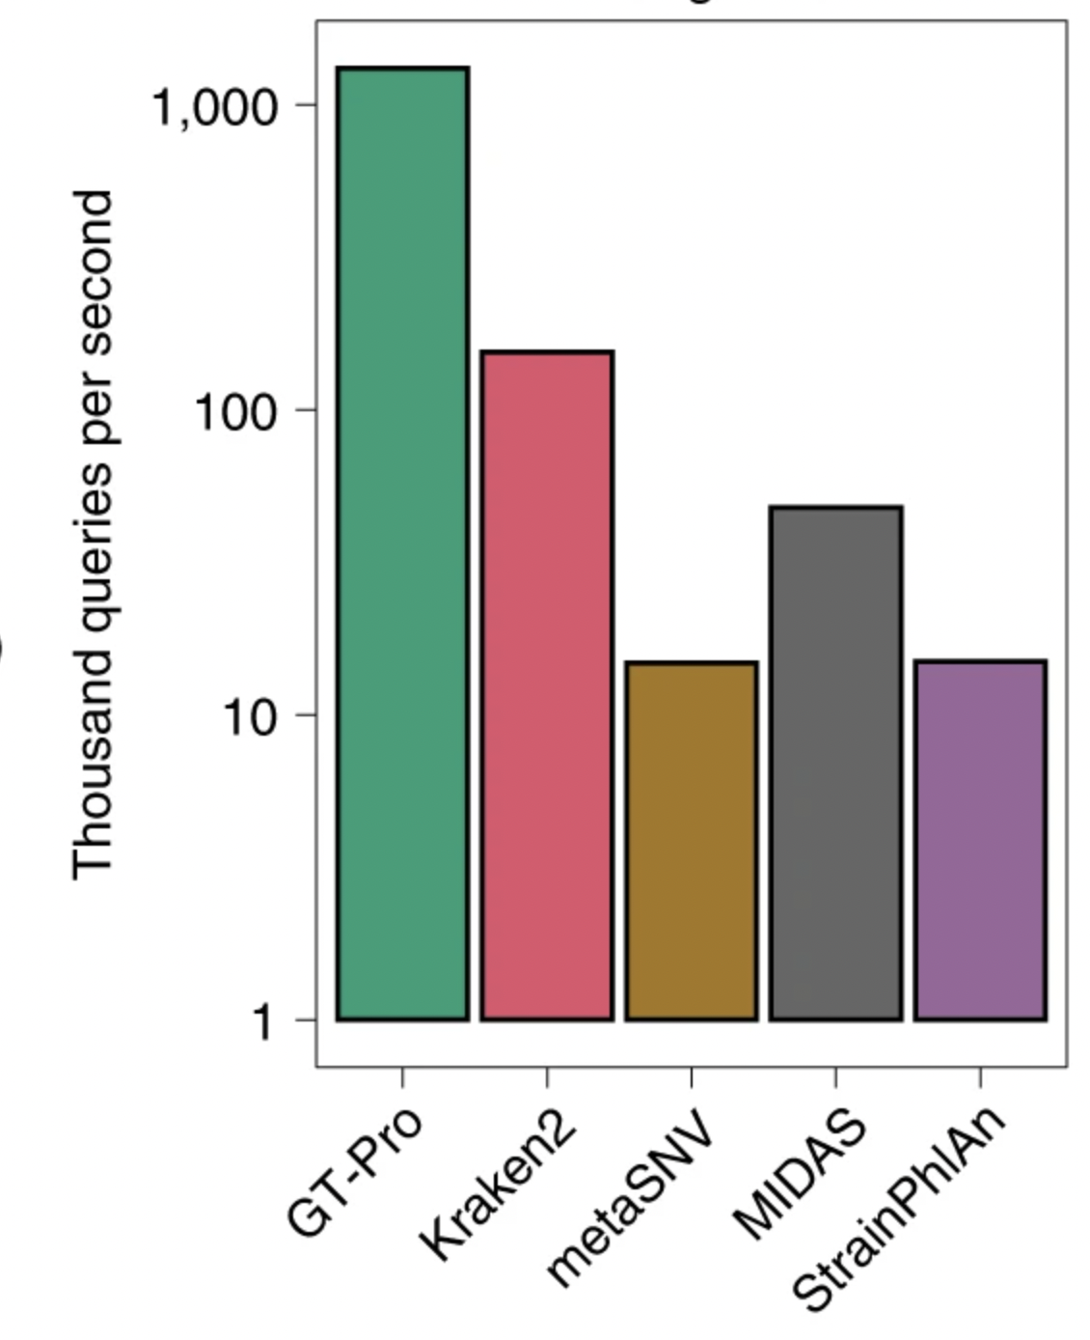
GT-Pro scales to tens-of-thousands of samples
Uses exact k-mer matching to accelerate metagenotyping
Tallies variants at known, bi-allelic SNPs in the core genome using a database of known SNVs
Notes:
And it really is fast. GT-Pro is about an order of magnitude faster than other metagenotypers
Making it possible to metagenotype hundreds of species in tens of thousands of human microbiome samples in publicly available sequence databases
However, while metagenotyping is now easy and fast…

Slide 30
Interpreting metagenotypes is challenging
Low sequencing coverage
Mixtures of strains
Closely related strains
Novel strains
Notes:
Interpreting metagenotypes is still hard
Specifically, four key challenges exist…
Metagenotypes for low abundance species can be sparse
Closely related strains may not be well differentiated by their metagenotype
Most strains may not have been previously characterized
And, crucially, as I’ve mentioned before, a single sample may have multiple, co-existing strains

Slide 31
Interpreting metagenotypes is challenging
Low sequencing coverage
Consensus Genotypes
Mixtures of strains
Closely related strains
Novel strains
Notes:
As a result, naive approaches to strain-inference are each handicapped by some combination of these challenges.
For instance, taking the consensus allele at each position in the metagenotype from one sample will only recover a dominant strain
And even then might be sparse

Slide 32
Interpreting metagenotypes is challenging
Low sequencing coverage
Mixtures of strains
Reference Database
Closely related strains
Novel strains
Notes:
Alternatively, using the observed SNVs as a “fingerprint” and matching to a database of known strains, fails when strain diversity has not already been well characterized.

Slide 33
Interpreting metagenotypes is challenging
Low sequencing coverage
Mixtures of strains
Dissimilarity Methods / Ordination
Closely related strains
Novel strains
Notes:
One especially popular approach has been to consider the the dissimilarity between metagenotypes using, for example, the cosine distance.
A cutoff dissimilarity is chosen below which samples are considered to have the “same strain”
Unfortunately, this approach doesn’t have a principled way to differentiate between shared strains in a mixture and genotypically similar strains.

Slide 34
Outline
Intraspecific diversity in the microbiome
Strain inference
Metagenotype deconvolution
Application to large metagenome collections
Notes:
So, if none of the other approaches is well suited to interpreting metagenotype data,
Let’s talk about an approach to strain inference—which I’m calling strain deconvolution—that gracefully handles all four of these challenges

Slide 35
Strain deconvolution
genome
1
1
0
2
1
…
2
1
3
1
2
Notes:
The key concept of the strain deconvolution approach is that we combine metagenotypes from multiple samples…

Slide 36
Strain deconvolution harnesses SNV covariance
…
genome
alt
1
2
0
1
0
1
1
0
2
1
…
ref
2
0
4
2
2
2
1
3
1
2
Notes:
To fill in sparse genotypes
And allowing us to use use covariance in the observed frequency of alleles at SNP positions
To disentangle strain mixtures

Slide 37
Non-negative matrix factorization for metagenotypes
Pos 1
Pos 2
Pos 3
Pos 4
Pos 5
Pos 6
Sample 1
Sample 2
Sample 3
Notes:
Strain deconvolution is analogous to non-negative matrix factorization (or NMF)
Here, multiple metagenotypes have been stacked into a matrix, where I’m depicting a higher frequency of the alternative allele with darker colors
(in this cartoonized version I’m showing just three samples, but we might consider many more)

Slide 38
Non-negative matrix factorization for metagenotypes
Sample 1
Sample 2
Sample 3
Like NMF: model allele fractions as linear combinations of strain genotypes
Pos 1
Pos 2
Pos 3
Pos 4
Pos 5
Pos 6
Strain A
Strain B
Sample 1
Sample 2
Sample 3
Notes:
This metagenotype matrix can be decomposed into
a matrix of strain genotypes (here a binary matrix of genotypes with each column a strain)
And a matrix of strain relative abundances across each of the samples
We can model the metagenotype matrix as a linear combination of the strain genotypes, i.e. the matrix product of the relative abundance matrix and the genotype matrix.

Slide 39
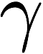
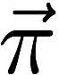
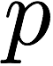
Strain deconvolution as model-based inference
Genotype
Like NMF: model allele fractions as linear combinations of strain genotypes
Except:
(S)
Strains
Strain Composition
Allele Fractions
(N) Samples
(G) Positions
Notes:
Alternatively, we can describe this deconvolution as a probabilistic graphic model
which I am showing here in an informal plate notation
(plates in the background indicate the indexing for each variable)
In this simplest model, “gamma”, the variable I’ll use throughout to refer to the strain genotypes
And “pi”, a vector of strain relative abundances
Combine (implicitly through matrix multiplication) to determine the allele frequencies: “p”
This model-based approach to deconvolution has a few key differences from canonical NMF…

Slide 40
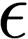
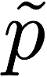
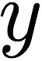
Strain deconvolution as model-based inference
Genotype
Like NMF: model allele fractions as linear combinations of strain genotypes
Except:
Counts observed (sequencing error, binomial likelihood)
(S)
Strains
Strain Composition
Error Rate
Allele Fractions
Expected Fractions
Allele Counts
(N) Samples
(G) Positions
Notes:
First, we can model the observed metagenotype counts, e.g. by explicitly modeling sequencing error and the discrete allele counts with a binomial likelihood

Slide 41
Strain deconvolution as model-based inference
Genotype
Like NMF: model allele fractions as linear combinations of strain genotypes
Except:
Counts observed (sequencing error, binomial likelihood)
Strain composition sums-to-1
(S)
Strains
Strain Composition
Error Rate
Allele Fractions
Expected Fractions
Allele Counts
(N) Samples
(G) Positions
Notes:
Second, unlike NMF where the only constraint is non-negativity, here we constrain the rows of “pi” to sum-to-1 (since they’re relative abundances)

Slide 42
Strain deconvolution as model-based inference
Genotype
Like NMF: model allele fractions as linear combinations of strain genotypes
Except:
Counts observed (sequencing error, binomial likelihood)
Strain composition sums-to-1
Genotypes at each position are binary, either 0 (reference) or 1 (alternative) allele
(S)
Strains
Strain Composition
Error Rate
Allele Fractions
Expected Fractions
Allele Counts
(N) Samples
(G) Positions
Notes:
And third, “gamma” can be modeled as binary: either the reference allele (0) or the alternative allele (1).
We can then use constrained optimization (e.g. maximum likelihood) to obtain estimates of gamma and pi, the strain genotypes and their relative abundances across samples.
I am aware of two existing tools that already implement this approach.
Unfortunately, there’s a shortcoming: discrete optimization is HARD

Slide 43
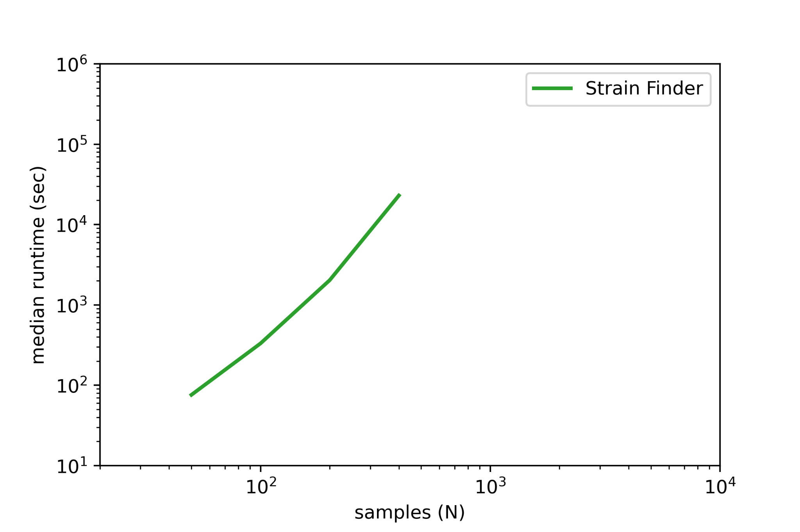
Computational scalability of existing deconvolution tools
Notes:
Here I’m showing the runtime of a tool called “Strain Finder”, which uses expectation maximization approach to optimizing the parameters of the model.
What you see is that over a 1 order-of-magnitude increase in the number of samples and strains, Strain Finder takes almost 3 orders-of-magnitude more time to estimate parameters.
For 400 samples and 120 strains, this requires a median of 6.4 hours on simulated data
Increasing the size of our model, e.g. by an additional order of magnitude, is simply not feasible within a reasonable runtime

Slide 44
Discrete genotypes are computationally challenging
Genotype
Like NMF: model allele fractions as linear combinations of strain genotypes
Except:
Counts observed (sequencing error, binomial likelihood)
Strain composition sums-to-1
Genotypes at each position are binary, either 0 (reference) or 1 (alternative) allele
(S)
Strains
Strain Composition
Error Rate
Allele Fractions
Expected Fractions
Allele Counts
(N) Samples
(G) Positions
Notes:
I believe that a major reason for this poor scaling is the discreteness of the genotypes, gamma
Strain Finder is limited by the computational scaling of its expectation maximization algorithm

Slide 45
StrainFacts relaxes the discrete allele constraint
Genotype
Like NMF: model allele fractions as linear combinations of strain genotypes
Except:
Counts observed (sequencing error, binomial likelihood)
Strain composition sums-to-1
Genotypes at each position are binary, either 0 (reference) or 1 (alternative) allele
Genotypes at each position are between 0 (reference) and 1 (alternative) alleles
(S)
Strains
Strain Composition
Error Rate
Allele Fractions
Expected Fractions
Allele Counts
(N) Samples
(G) Positions
Notes:
Which brings us to the key approach taken by my tool:
In StrainFacts, which stands for Strain Factorization…
We replace the binary genotype constraint with a fuzzy genotype: on the unit interval between 0 and 1.
This TRANSFORMS our model from discrete to fully differentiable, and allows us to apply efficient, gradient-based methods for parameter optimization.

Slide 46
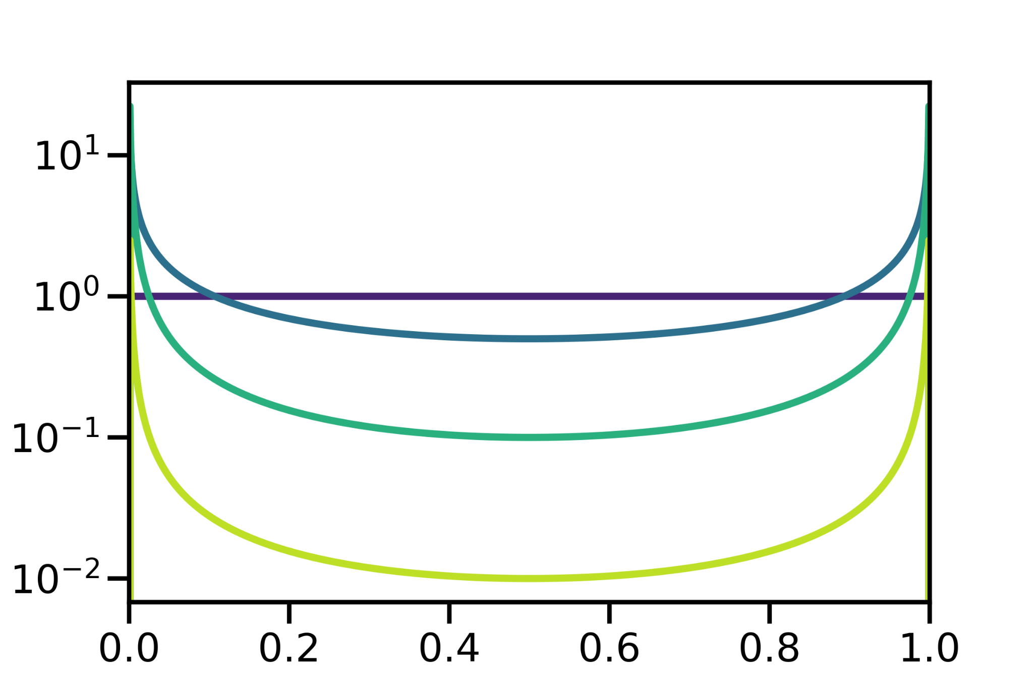
StrainFacts relaxes the discrete allele constraint
Genotype
By putting a strong prior on γ, we encourage fuzzy genotypes to be closer to 0 or 1
Shifted-scaled Dirichlet distribution (SSD; similar to the Dirichlet/Beta)
(S)
Strains
Strain Composition
Error Rate
Allele Fractions
Expected Fractions
Allele Counts
(N) Samples
(G) Positions
Notes:
You might notice that fuzzy genotypes are not biologically realistic, since alleles are discrete.
To deal with this issue without losing differentiability, we take a regularization approach, putting a prior on gamma that keeps genotypes close to 0 or 1, despite their fuzziness
Specifically, we use the shift-scaled dirichlet distribution for this fuzzy approximation, tuning the scaling parameter to regularize our estimates towards binary values.

Slide 47
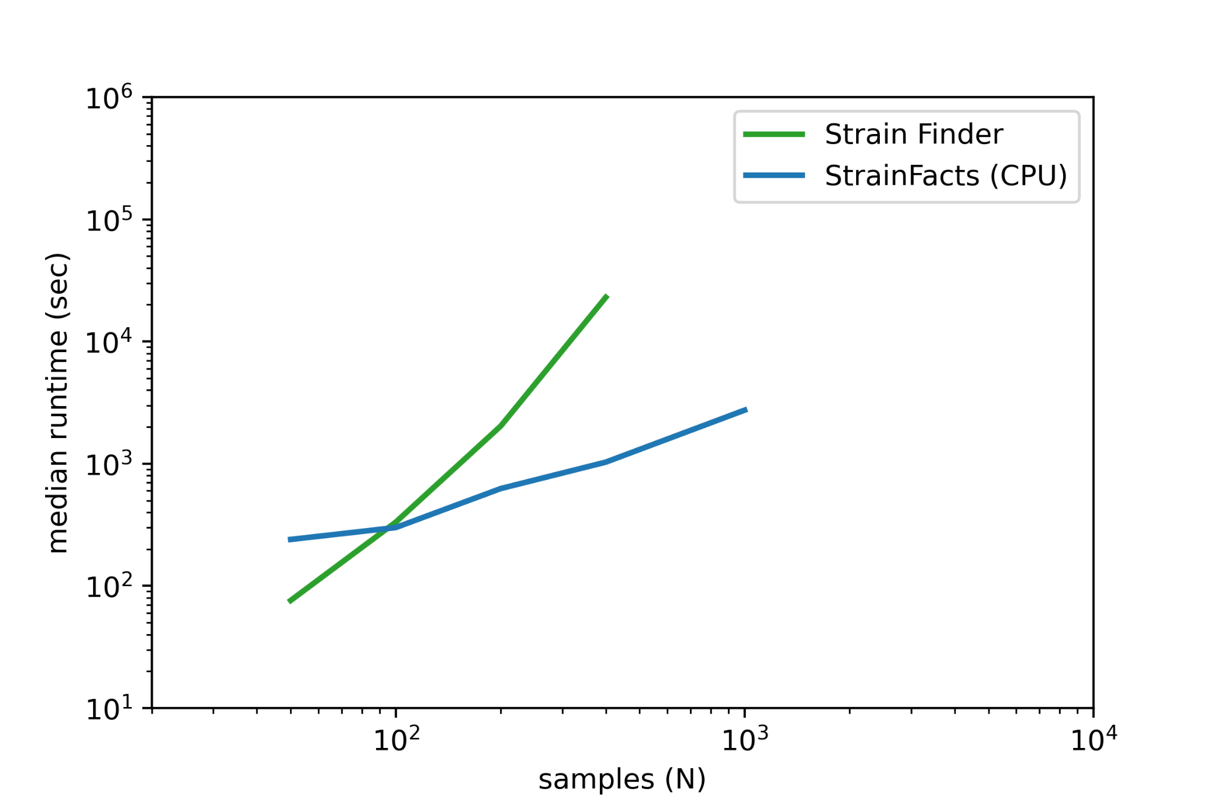
Fuzzy genotypes and gradient descent can scale to thousands of samples
Notes:
And it works!
We get much better scaling with StrainFacts than Strain Finder, a nearly two order of magnitude decrease in runtime for larger models.

Slide 48
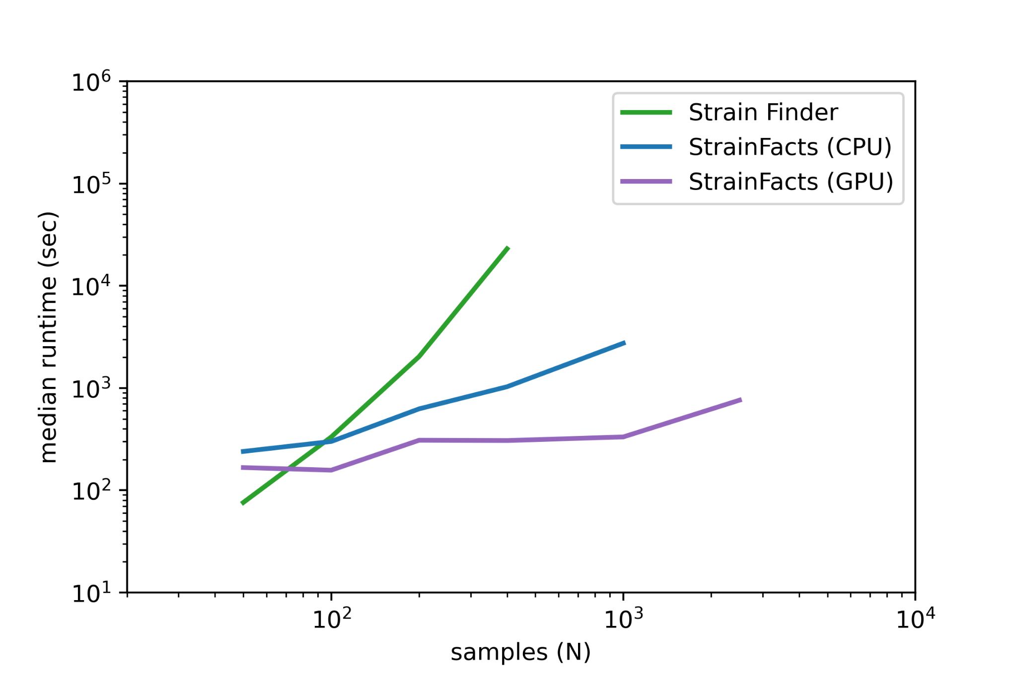
Fuzzy genotypes and gradient descent can scale to thousands of samples
Notes:
What’s more, we can run StrainFacts on a GPU, further improving our runtime for large models
StrainFacts is therefore capable of fitting very large models with thousands or tens-of-thousands of samples and hundreds of strains

Slide 49
StrainFacts regularizes strain heterogeneity and diversity
Genotype
Additionally, we put a hierarchical prior on π
Strain heterogeneity regularization (strains per sample)
(S)
Strains
Strain Composition
Error Rate
Allele Fractions
Expected Fractions
Allele Counts
(N) Samples
(G) Positions
Notes:
Besides these fuzzy genotypes, StrainFacts also applies regularization to strain relative abundances
We push estimates towards a smaller number of active strains in each sample

Slide 50
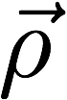
StrainFacts regularizes strain heterogeneity and diversity
Metacommunity
Genotype
Additionally, we put a hierarchical prior on π
Strain heterogeneity regularization (strains per sample)
Overall strain diversity regularization
(S)
Strains
Strain Composition
Error Rate
Allele Fractions
Expected Fractions
Allele Counts
(N) Samples
(G) Positions
Notes:
And, with a hierarchical prior, we also regularize the overall diversity towards fewer strains
This regularization reflects our preference for greater parsimony
And, since we don’t need a secondary model selection step to choose a strain number,
The computational demands of our approach is further reduced

Slide 51
Strain deconvolution as model-based inference
Metacommunity
Genotype
Additionally, we put a hierarchical prior on π
Strain heterogeneity regularization (strains per sample)
Overall strain diversity regularization
Full model also includes count over-dispersion (Beta-Binomial likelihood)
Maximum a posteriori (MAP) estimation for inference
(S)
Strains
Strain Composition
Error Rate
Allele Fractions
Expected Fractions
Allele Counts
(N) Samples
(G) Positions
Notes:
Finally, to complete this description of the StrainFacts model
I’ll add that we also use a Beta-Binomial likelihood, to model count overdispersion

Slide 52
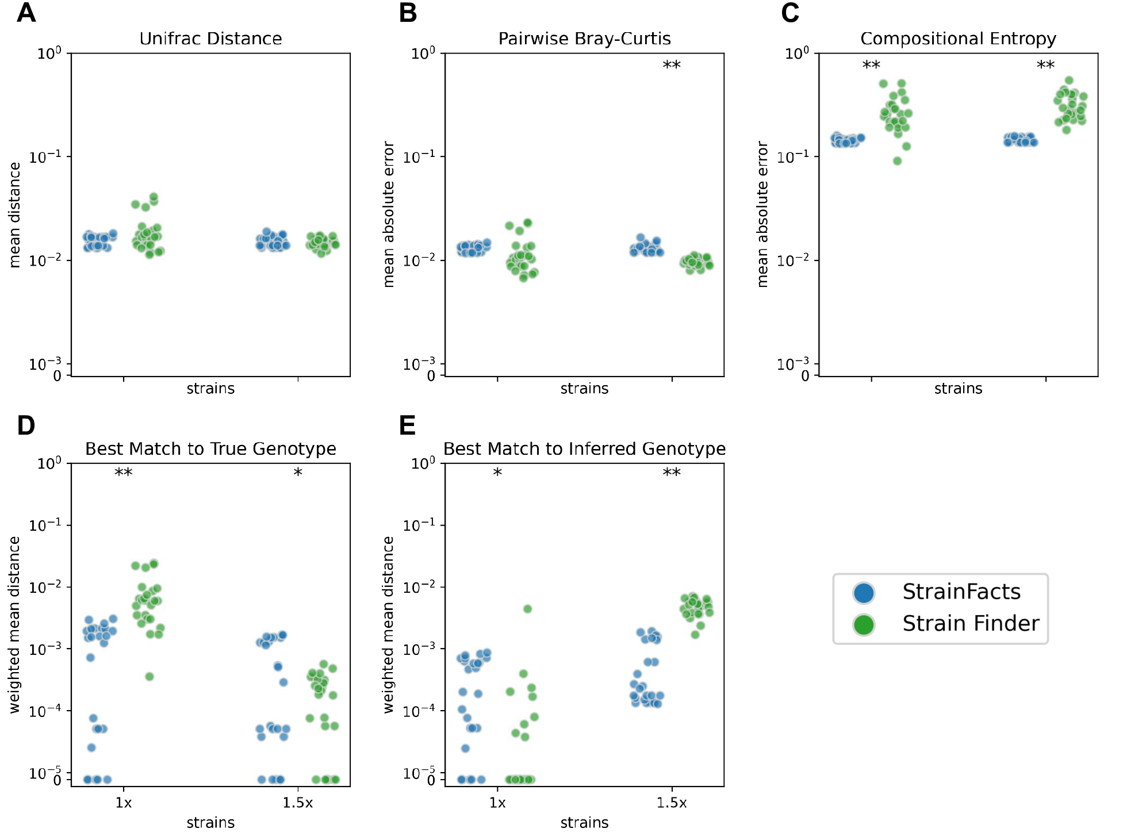
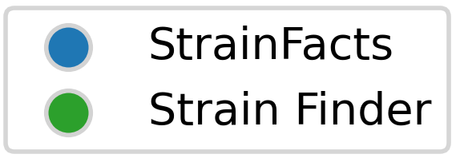
StrainFacts is accurate
Based on simulations, StrainFacts is similarly accurate to an existing deconvolution tool
Several orders of magnitude faster
Notes:
The accuracy of our inferences is, of course, important
We use simulations to compare our estimates to a ground truth
And find that StrainFacts estimates are comparable to those obtained by Strain Finder
(while being several orders of magnitude faster)

Slide 53
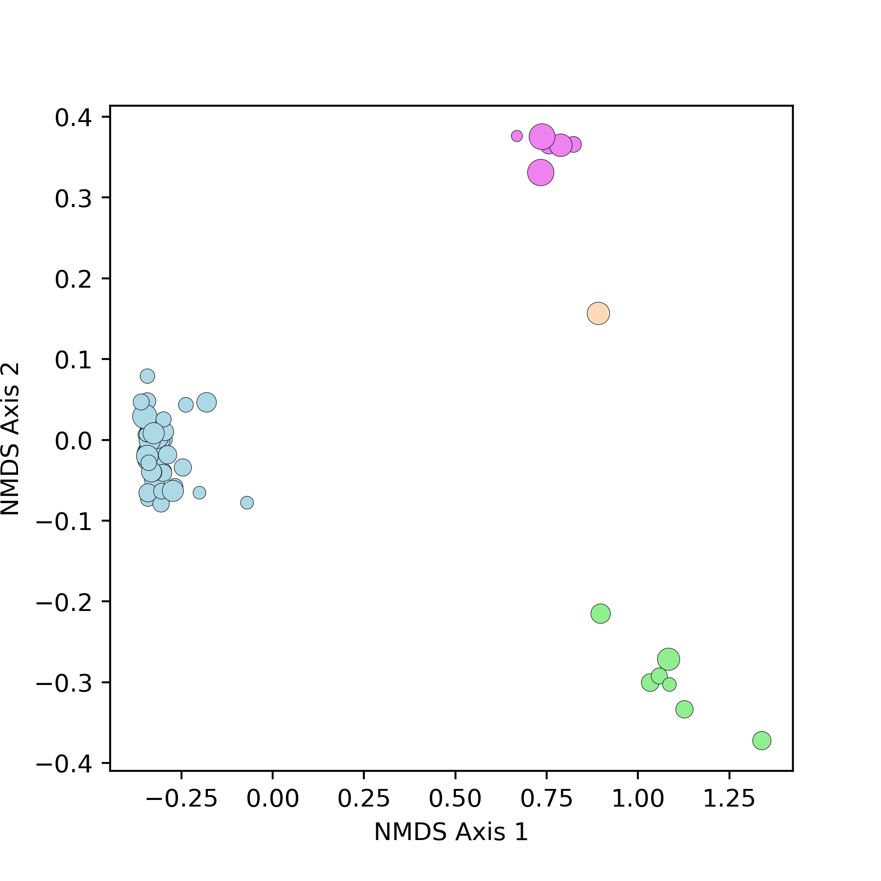
Single-cell genomics validates inferences in complex strain mixtures
Streptococcus thermophilus single-cell genotypes cluster into four groups
Xiangpeng Li
Notes:
But simulations don’t necessarily capture all of the features of real data
To validate our inferences we applied single-cell genomics to one sample from a larger study of ulcerative colitis patients
Single-cell genomics captures a sparse representation of the genotypes of individual cells in a sample, and therefore reflects individual strains
On this slide I’m showing an ordination of these single-cell genotypes for one species, Streptococcus thermophilus.
Closer points reflect more similar genotypes, based on the Hamming distance
What you can see is that in this sample, S. thermophilus has a remarkable amount of strain diversity: with genotypes clustering into four distinct types, here highlighted by colors.

Slide 54
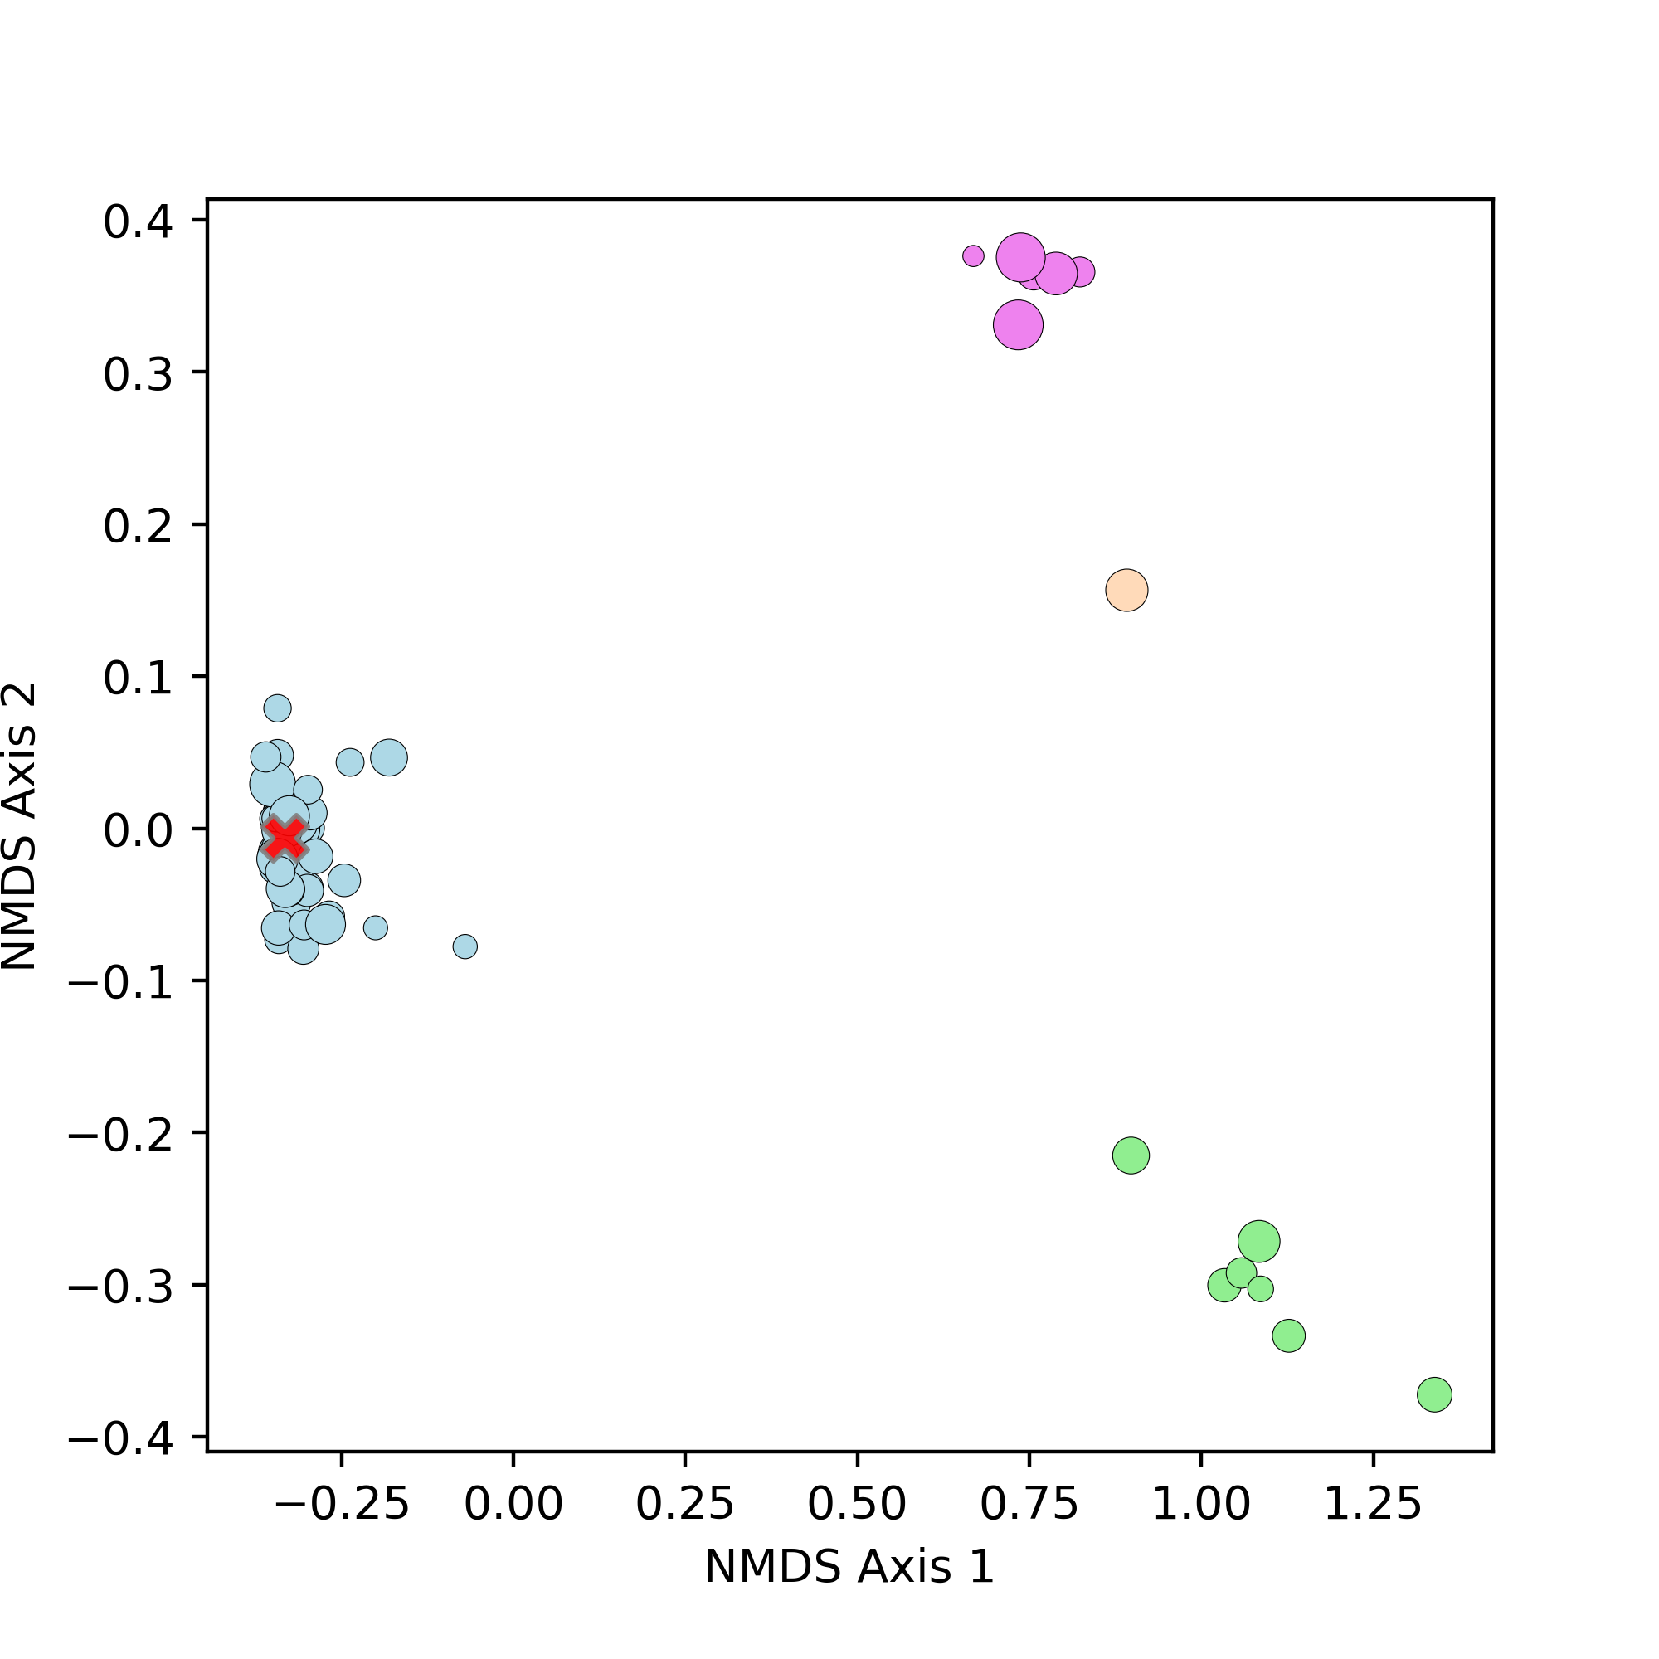
Single-cell genomics validates inferences in complex strain mixtures
Streptococcus thermophilus single-cell genotypes cluster into four groups
Consensus metagenotype only reflects dominant strain
Xiangpeng Li
Notes:
Adding the consensus metagenotype to this plot (red “x”), you can see that the majority-vote genotype reflects the majority strain, while completely missing the three other clusters.

Slide 55
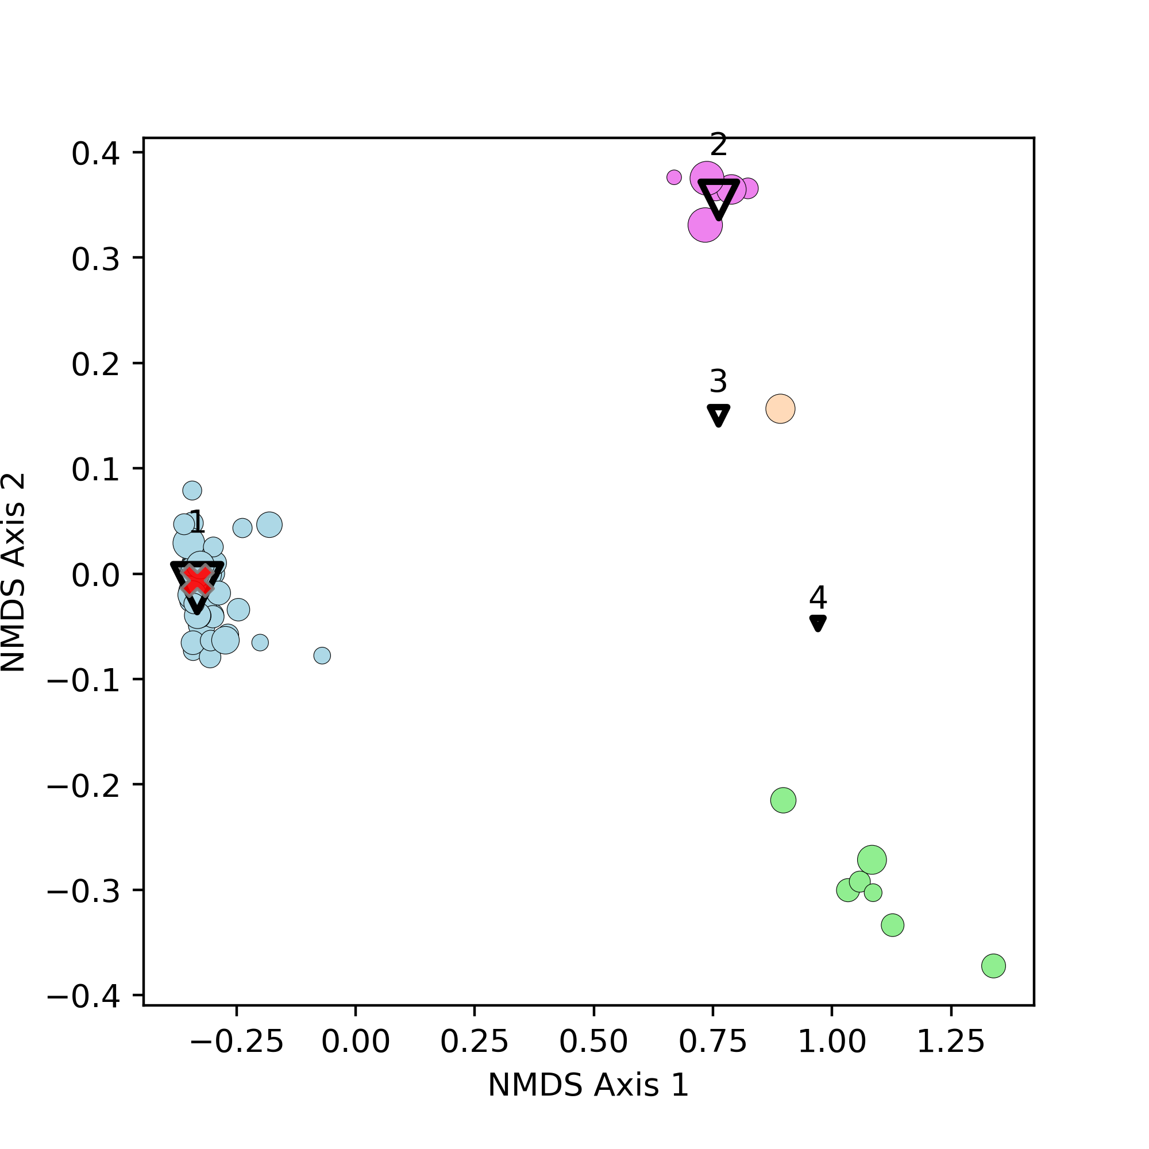
Single-cell genomics validates inferences in complex strain mixtures
Streptococcus thermophilus single-cell genotypes cluster into four groups
Consensus metagenotype only reflects dominant strain
StrainFacts identifies four strains, three of which match the single-cell genotypes
Xiangpeng Li
Notes:
On the other hand, StrainFacts correctly infers that there are four distinct strains, here shown as black triangles
For three of the four inferred strains, these inferred strains match the single-cell genomes closely, suggesting that StrainFacts is capable of accurate inference in real biological data even for species with a high degree of strain heterogeneity.
And, while for the fourth cluster the similarity is not so clear, this strain was estimated to be at the lowest relative abundance, suggesting that there may not have been enough information to infer this genotype.

Slide 56
Outline
Intraspecific diversity in the microbiome
Strain inference
Metagenotype deconvolution
Application to large metagenome collections
Notes:
For the remainder of this talk I want to show you some of what we found when we applied StrainFacts to real data

Slide 57
What can we do with strain inference across thousands of metagenomic samples?
Notes:
Because of rapid metagenotyping thanks to GT-Pro, we now have access to metagenotypes for tens of thousands of metagenomic samples across numerous independent human microbiome studies.

Slide 58
What can we do with strain inference across thousands of metagenomic samples?
Two examples:
Biogeography
Population Genetics
Notes:
I’d like to share two vignettes that demonstrate the value of StrainFacts for:
Understanding microbial biogeography
Studying microbial population genetics

Slide 59
Strain biogeography
Agathobacter rectalis is a prevalent and abundant gut bacterium
20 countries → 33 studies → 9,224 stool samples → 198 inferred strains
Notes:
Agathobacter rectalis (previously known as Eubacterium rectale) is a prevalent and abundant member of the human gut microbiome.
Across dozens of studies, about 10,000 samples had sufficient coverage of A. rectalis SNPs to deconvolve strains.
This resulted in 198 inferred strains
Access to sample metadata for many of the available metagenomic samples means that we can also ask about the association between strains and the country where that sample was collected

Slide 60
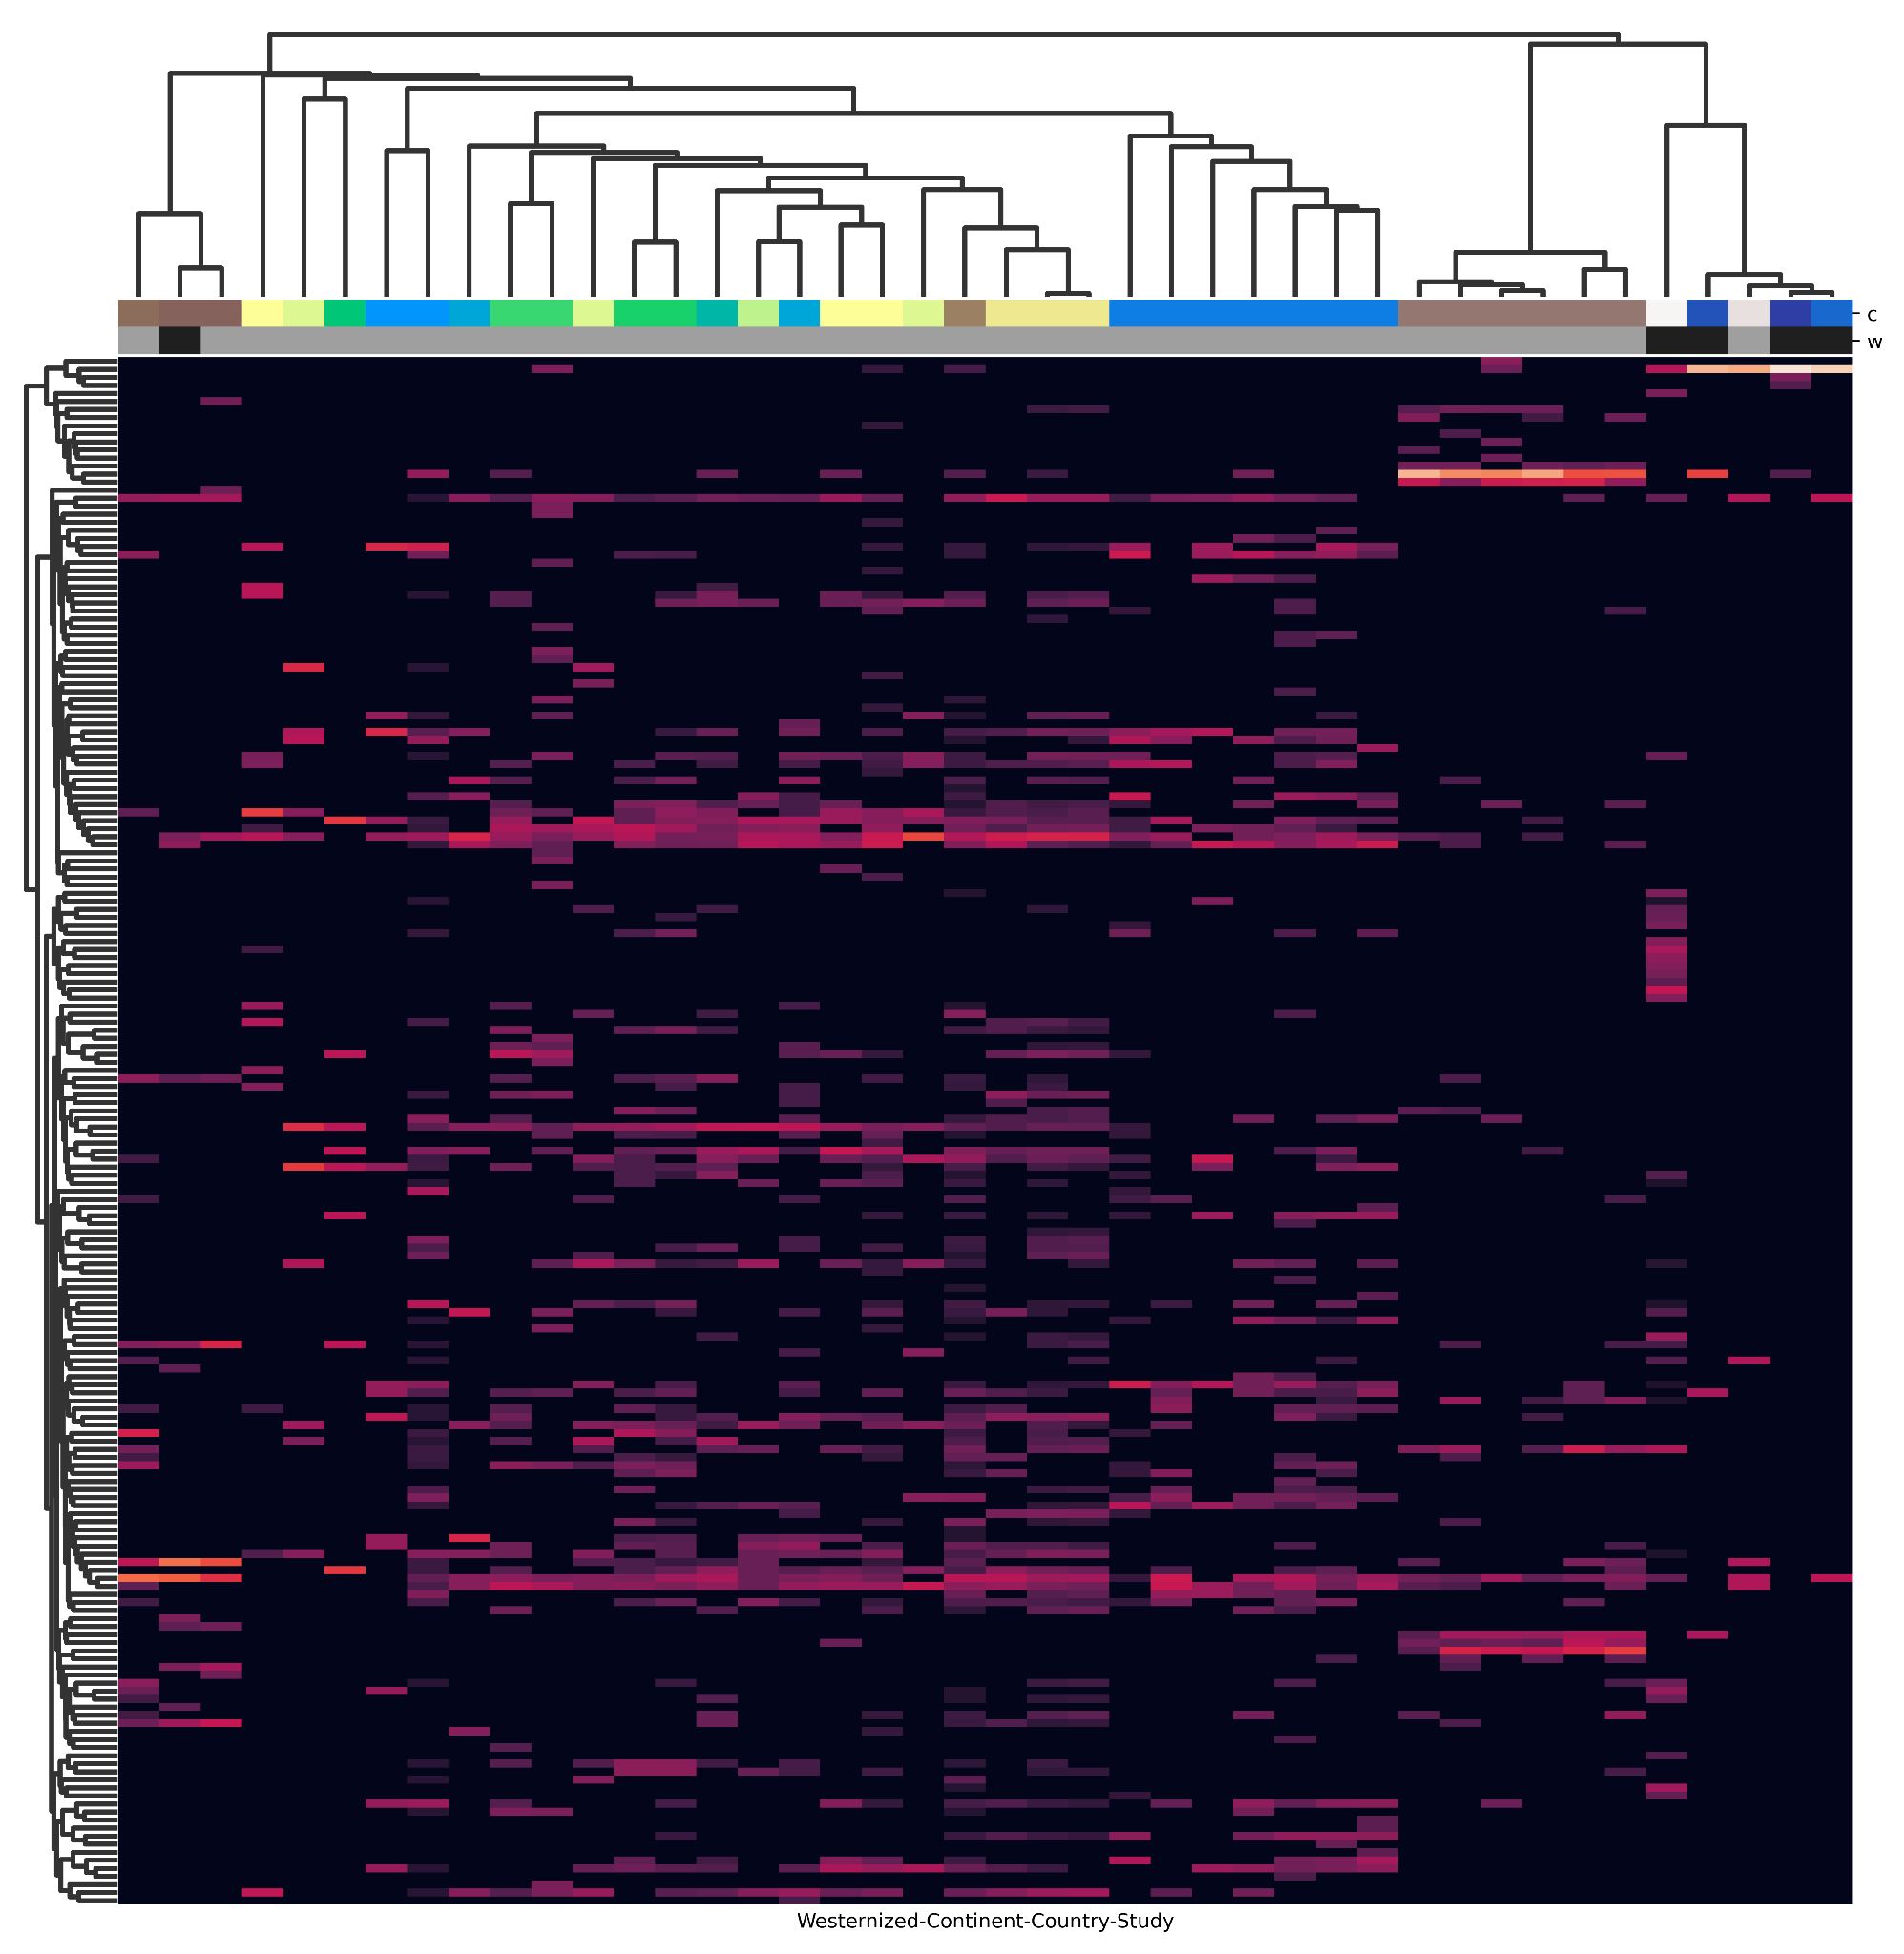
Strain biogeography
Agathobacter rectalis is a prevalent and abundant gut bacterium
20 countries → 33 studies → 9,224 stool samples → 198 inferred strains
Notes:
This heatmap summarizes the distribution of the 198 inferred strains (rows) across 33 studies (columns) with a minimum of 10 human stool metagenomes.
Each column summarizes a single study, with the brighter colors reflecting a larger fraction of samples dominated by each strain (row)
Columns are sorted based on similarities in this dominance profile
You’ll also see that columns have been colored by the study country
You also might notice that these study profiles seem to cluster:
While several strains are found across many studies,
Some are much more prevalent in a subset of these

Slide 61
Strain biogeography
Agathobacter rectalis is a prevalent and abundant gut bacterium
20 countries → 33 studies → 9,224 stool samples → 198 inferred strains
Strains reflect which country samples were collected in across independent studies
Notes:
Since these colors can be a bit hard to parse, here I’ve highlighting all six studies performed in China
You’ll see that these cluster closely together, and are characterized by a couple of distinct strain groups
This is consistent with previous reports of a subspecies of A. rectalis highly enriched in Chinese metagenomes.

Slide 62
Strain biogeography
Agathobacter rectalis is a prevalent and abundant gut bacterium
20 countries → 33 studies → 9,224 stool samples → 198 inferred strains
Strains reflect which country samples were collected in across independent studies
Notes:
But China is not the only country where independent studies cluster together.
This box highlights 7 studies performed in the US
While these studies are not as distinctly/visibly different as the studies from China, they still cluster together
What I think is particularly exciting about this is that each columns represents a completely INDEPENDENT study of human stool samples, with different subjects and protocols
But they nonetheless clearly reflect the geographic origin based on the dominant A. rectalis strains

Slide 63
Strain biogeography
Agathobacter rectalis is a prevalent and abundant gut bacterium
20 countries → 33 studies → 9,224 stool samples → 198 inferred strains
Strains reflect which country samples were collected in across independent studies
Notes:
And, to a less dramatic extent, this geographic clustering also extends to many of the remaining studies from across Europe and Canada
(Although this clustering is not perfect)
I’m really excited by the potential for tracking strains across human populations to inform our understanding of how microbes are transmitted between individuals globally.
Not to mention identifying associations with human physiology, diet, and disease

Slide 64
Population genetics
Notes:
Finally, I want to talk about the potential for strain inferences to inform our understanding of microbial population structure and evolution

Slide 65
Population genetics
Linkage disequilibrium
Correlations between SNPs reflect shared descent
In asexual organisms, SNPs stay correlated
Notes:
But first, a quick refresher on linkage disequilibrium
When we look across polymorphic sites in the genome, we see that we can use the variants that we see at one position to predict the variants at other positions
This correlation between alleles at SNP sites is called linkage, and reflect the shared inheritance of the sites together, as a unit
In perfectly asexual organisms, this linkage is only broken by subsequent mutations at one of the sites.

Slide 66
Population genetics
Linkage disequilibrium
Correlations between SNPs reflect shared descent
In asexual organisms, SNPs stay correlated
SNPs that are not correlated reflect recombination
Notes:
However, this correlation can also be broken due to recombination.

Slide 67
Population genetics
Linkage disequilibrium
Correlations between SNPs reflect shared descent
In asexual organisms, SNPs stay correlated
SNPs that are not correlated reflect recombination
We can see greater chance of recombination occurring between SNPs that are farther apart in the genome
Notes:
And, since this is a spatial process, SNPs that are further apart are more likely to be separated by recombination

Slide 68
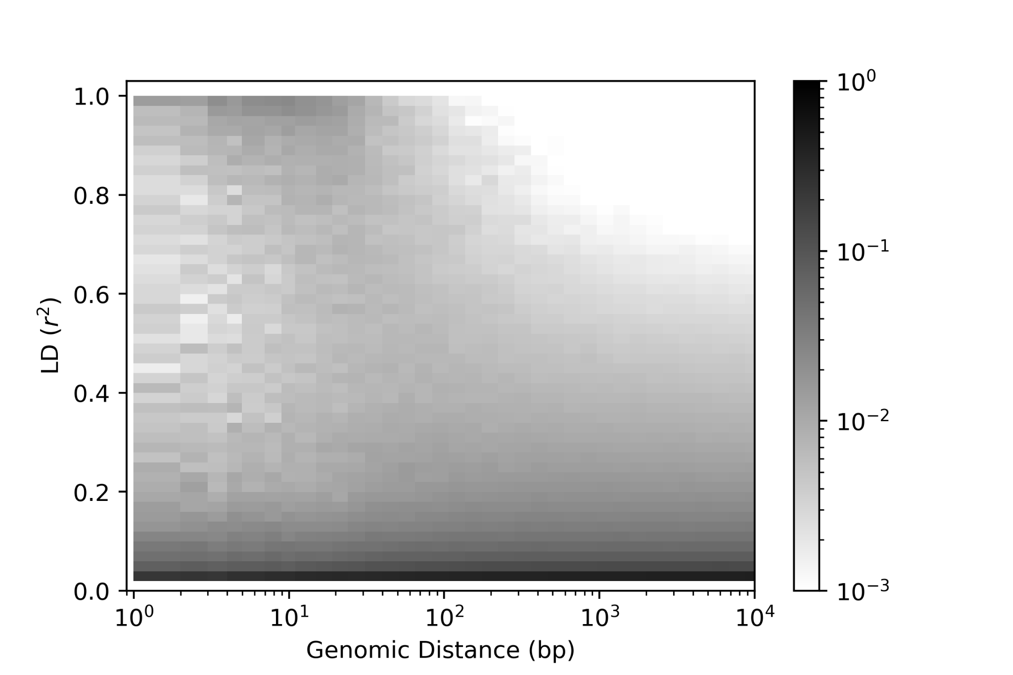
Population genetics
Notes:
As a result, we can use the relationship between genomic distance (here on the x-axis) and linkage disequilibrium (on the y) to understand recombination in microbes

Slide 69
Population genetics
Notes:
LD is a property of pairs of SNPs
and we can compare the pairwise LD and distance for all pairs of SNPs

Slide 70
Population genetics
Decay of LD for pairs at larger distances reflects recombination
Notes:
The expectation is that, in the presence of recombination, LD will drop quickly with distance.
And this LD decay is one way to detect recombination in microbes.

Slide 71
Population genetics
Decay of LD for pairs at larger distances reflects recombination
In E. coli, this is exactly what we see
Notes:
For Escherechia coli, this is exactly what we see.
Here I’m showing a two dimensional histogram, where each column reflects the distribution of pairs at that distance
And the darker shades indicate more pairs with that LD

Slide 72
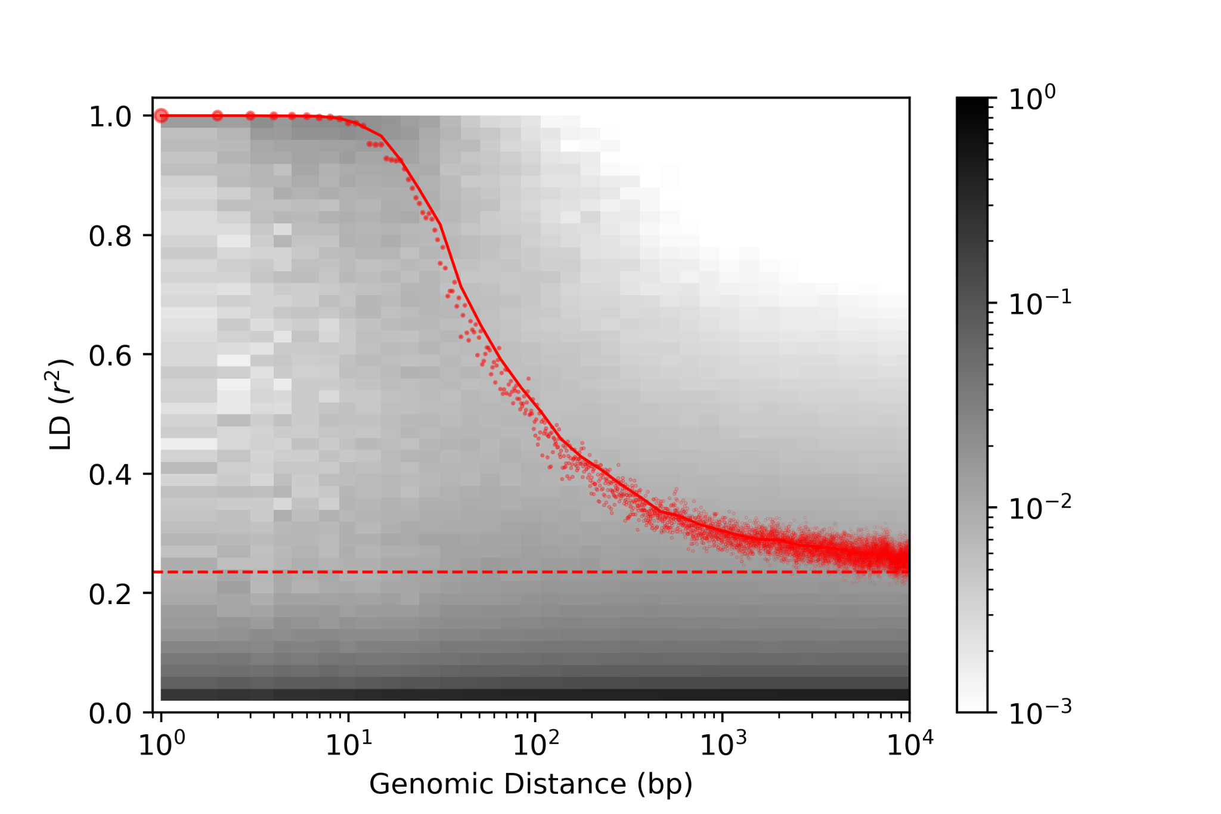
Population genetics
Decay of LD for pairs at larger distances reflects recombination
In E. coli, this is exactly what we see
Linkage disequilibrium quickly decays with distance, reflecting extensive recombination
Notes:
And here I’ve plotted the 90th-percentile LD for SNP pairs at a range of distances in the genome
You can see that LD starts very high for neighboring SNPs and then quickly decays, before leveling out at larger distances
This suggests both that recombination has occurred frequently in the E. coli population
And that we’re still seeing some population structure (i.e. E. coli is not a panmictic species)

Slide 73
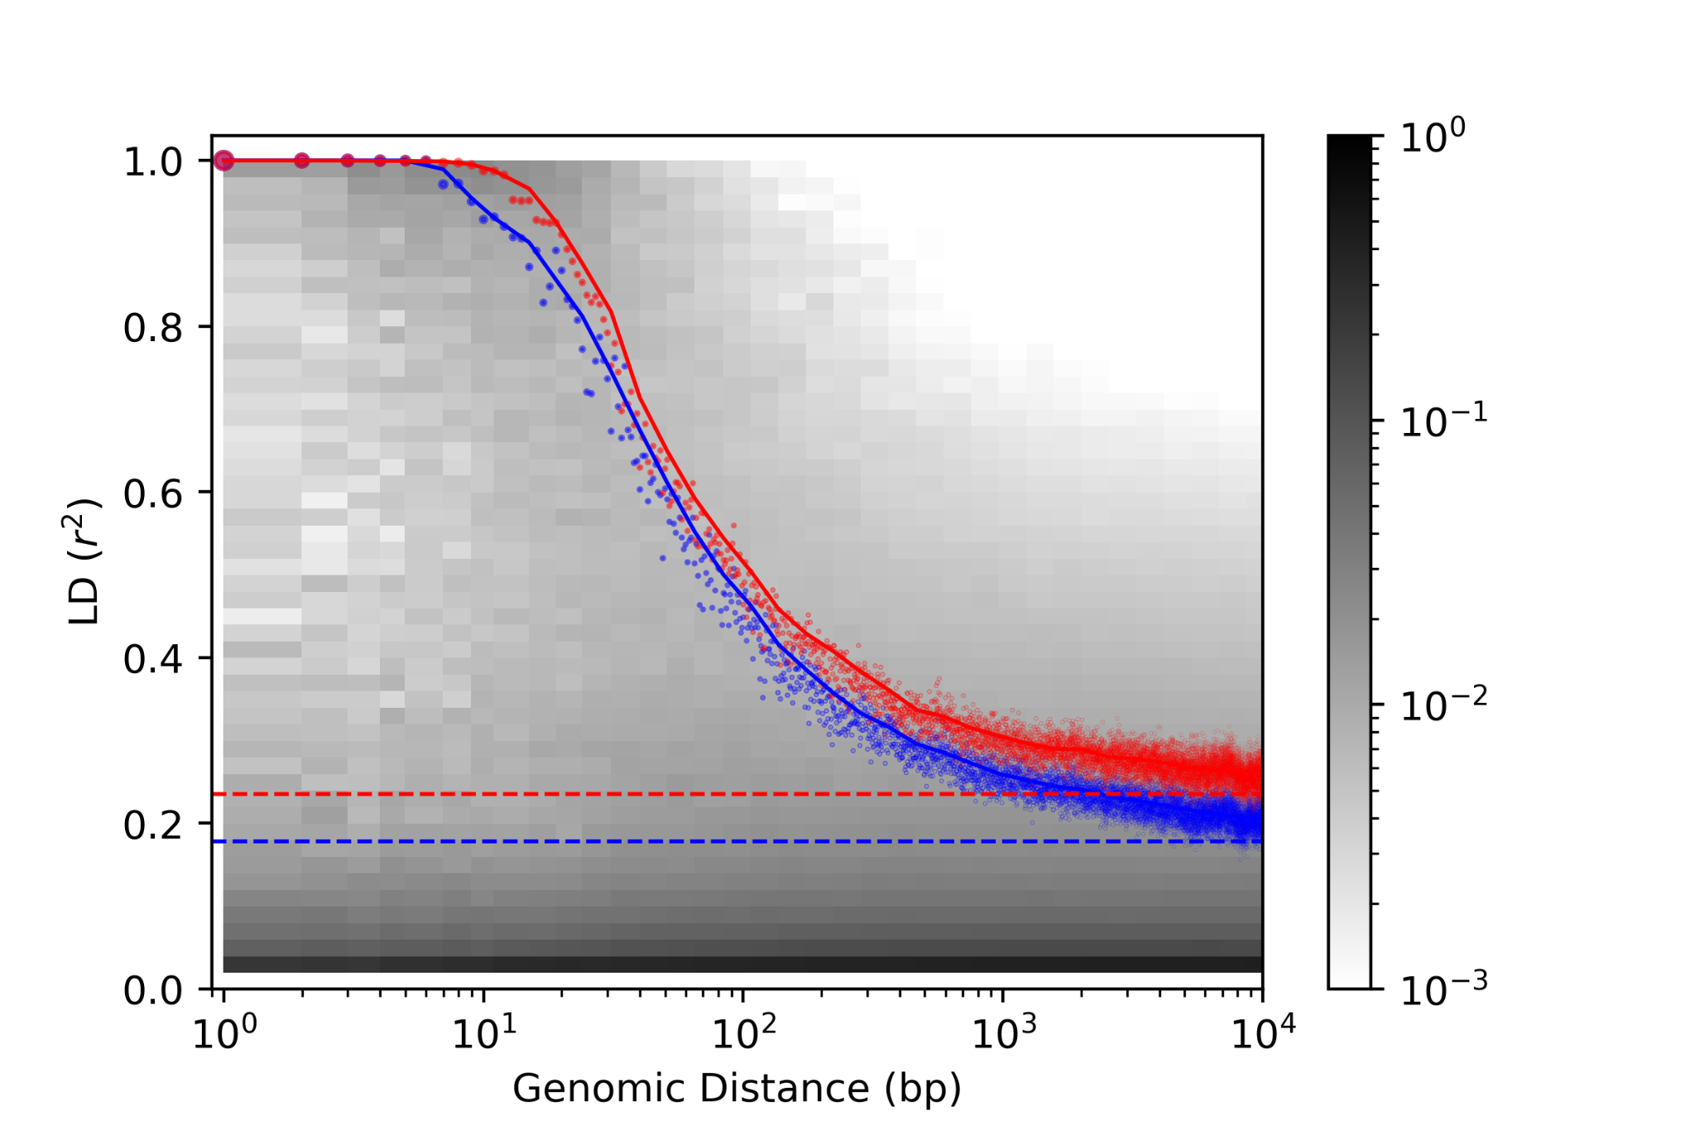
Population genetics
Decay of LD for pairs at larger distances reflects recombination
In E. coli, this is exactly what we see
Linkage disequilibrium quickly decays with distance, reflecting extensive recombination
This is consistent with what we independently calculate using reference genomes
Notes:
What’s more, because E. coli is very well-studied, we can confirm this finding using reference strains
which I’ve now added to this plot as a blue profile.
You can see that these results are both qualitatively and quantitatively very similar to the de novo estimates

Slide 74
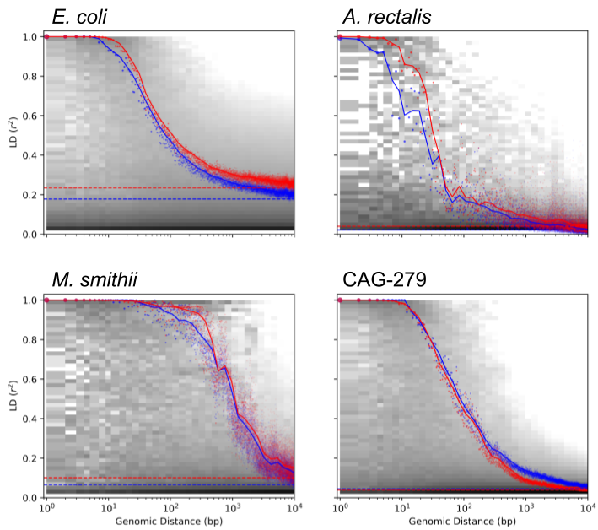
Population genetics
Decay of LD for pairs at larger distances reflects recombination
In E. coli, this is exactly what we see
Linkage disequilibrium quickly decays with distance, reflecting extensive recombination
This is consistent with what we independently calculate using reference genomes
Notes:
And this result isn’t limited to E. coli
Here I’ve extend this analysis to A. rectalis, as well as M. smithii, the most abundant archaeon in the human gut, as well as CAG-279, a unnamed and never-isolated species of bacterium.
We observe distinctly different LD-decay profiles for each
Different decay rates, and different long-distance LD
Comparative population genetics is potentially a valuable tool for understanding population structure and recombination across species

Slide 75
Summary and Conclusions
Deconvolution integrates strain quantification and genotype reconstruction
StrainFacts scales the approach to tens-of-thousands of metagenomes
Validated with simulations and single-cell genomics
Enables microbial biogeography, population genetics, and more at a global scale
Notes:
So, in summary, deconvolution leverages metagenotypes to quantify strain abundance and reconstruct genotypes
StrainFacts scales this approach to datasets the size of publicly available data from many studies
We were able to validate our tool using simulations and single-cell genomics
And we find that it has biologically interesting applications across a number of fields

Slide 76
Summary and Conclusions
Deconvolution integrates strain quantification and genotype reconstruction
StrainFacts scales the approach to tens-of-thousands of metagenomes
Validated with simulations and single-cell genomics
Enables microbial biogeography, population genetics, and more at a global scale
Questions?
Notes:
Thank you very much for your attention and I’d love to take any questions

Slide 77
Pocket Slides

Slide 78
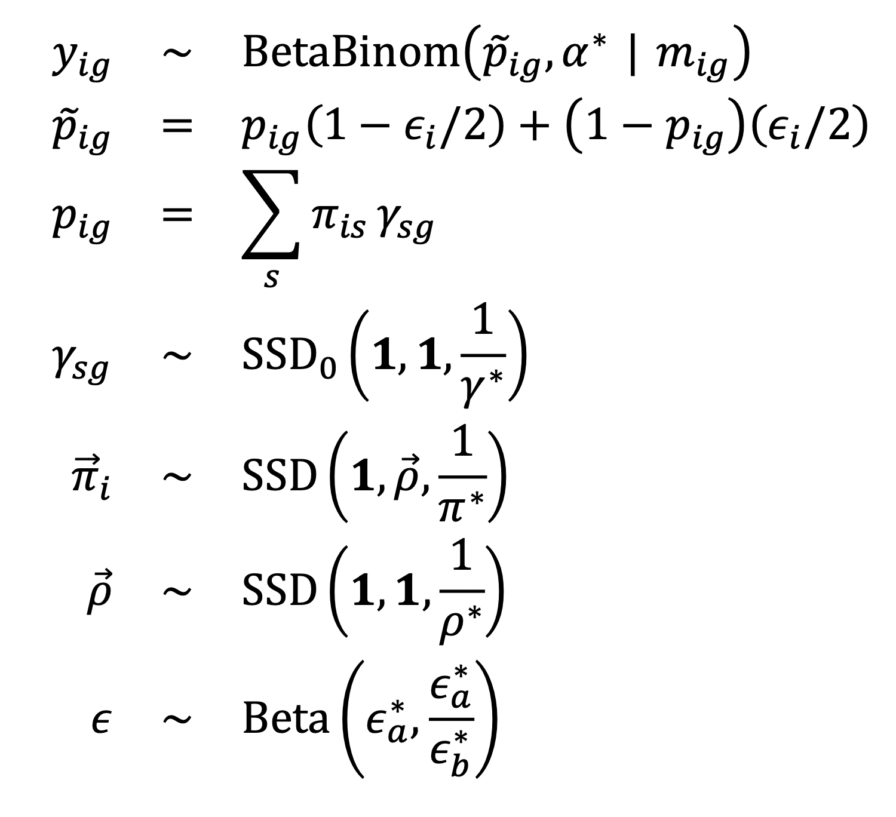
Metacommunity
Genotype
(S)
Strains
Strain Composition
Error Rate
Allele Fractions
Expected Fractions
Allele Counts
(N) Samples
(G) Positions

Slide 80
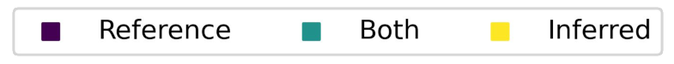
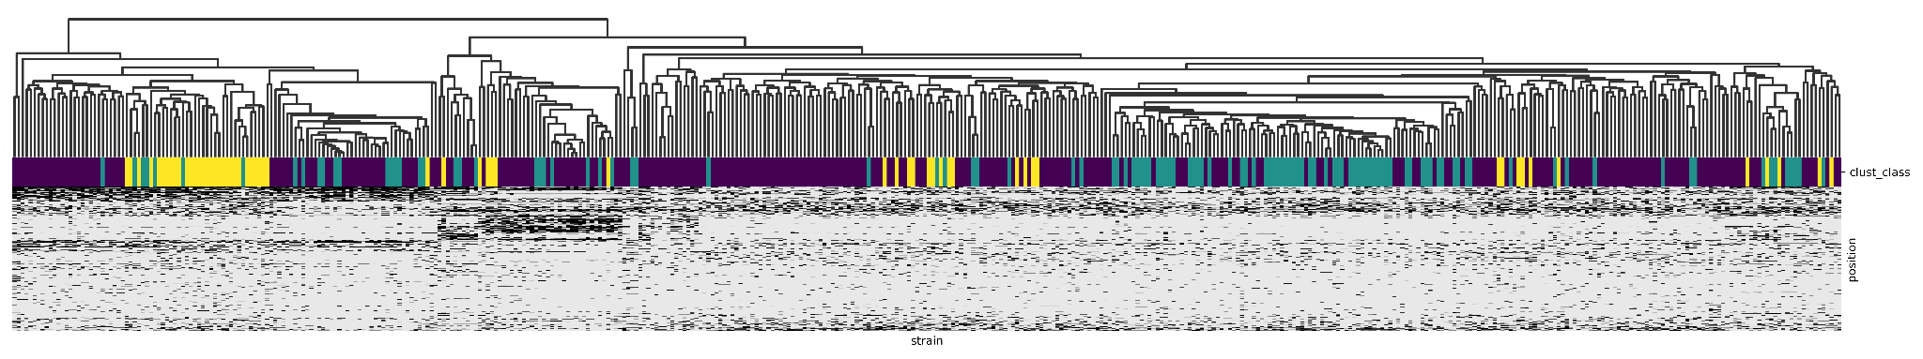
Cataloging strain diversity
Agathobacter rectalis is a prevalent and abundant gut bacterium
Dozens of studies → 11,860 samples → 198 inferred strains / 752 references
De novo strains reflect much of the diversity previously seen in references

